Slide 1
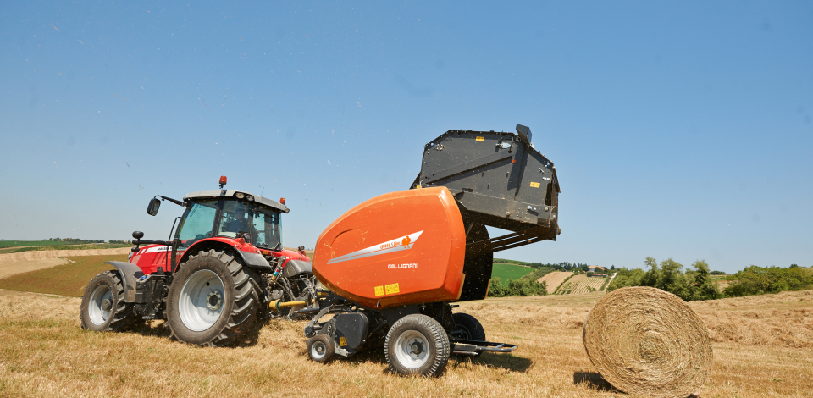
Gallignani Variable Chamber Round Balers
Product Information 2016

Slide 2
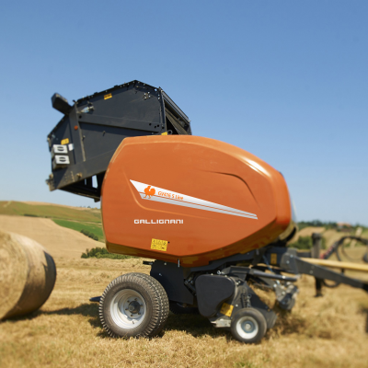
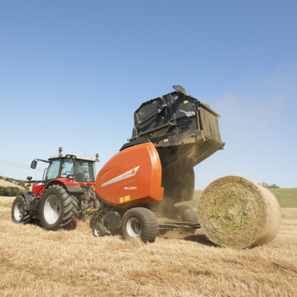
GV 416- 418 S-Line
GV 516- 520 Pro-Line
Open / Dry Crop
Variable Chamber Baler
Immediate Rolling / Wet Crop
Variable Chamber Baler

Slide 3
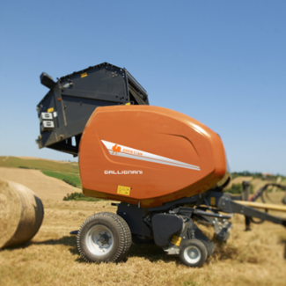
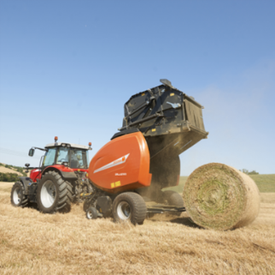
Variable Chamber Round Balers
Variable Balers
Dry Crop Ch.
1.65m Bale Ø
Variable Balers
Dry Crop Ch.
1.80m Bale Ø
Variable Balers
Wet Crop Ch.
1.65m Bale Ø
Variable Balers
Wet Crop Ch.
2.00m Bale Ø
Feeder Fork
GV 416 F S-Line
GV 418 F S-Line
DuoFeed double feeder fork
GV416 FD S-Line
GV418 FD S-Line
PowerFeed rotor feeder
GV 416 R S-Line
GV 418 R S-Line
GV 516 R ProLine
GV 520 R ProLine
SuperCut 14 knives
GV 516 SC14 ProLine
GV 520 SC14 ProLine
SuperCut 25 knives
GV 516 SC25 ProLine
GV 520 SC25 ProLine

Slide 4
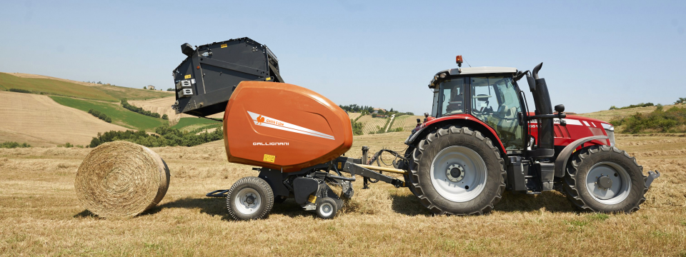

Gallignani GV 416 – 418 S-Line
Overview
Model | Bale Diameter | Intake | Binding
GV416 F | 1.2 x 0.8-1.65m | Fork Feeder | Twine, Net, Double
GV416 FD | 1.2 x 0.8-1.65m | DuoFeed Fork | Twine, Net, Double
GV416 R | 1.2 x 0.8-1.65m | PowerFeed Rotor | Twine, Net, Double
GV418 F | 1.2 x 0.8-1.80m | Fork Feeder | Twine, Net, Double
GV418 FD | 1.2 x 0.8-1.80m | DuoFeed Fork | Twine, Net, Double
GV418 R | 1.2 x 0.8-1.80m | PowerFeed rotor | Twine, Net, Double

Slide 5
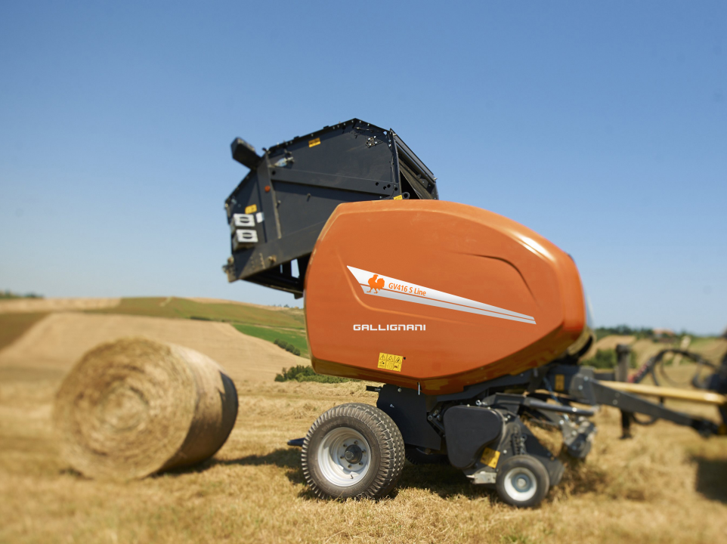

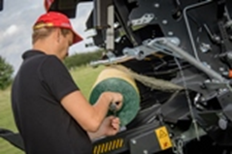
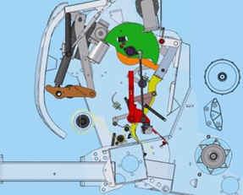
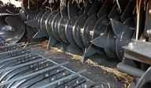
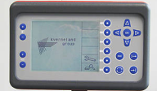
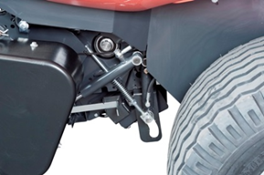

Highlights
Easy Netting
Easy and simple
loading of net rolls for
full operator’s comfort
Intake System
PowerBind
New net and twine
binding system
Cost efficient Fork Feeder (single or double) or high capacity PowerFeed rotor
Focus Terminal
Bale Density
Simple and intuitive Focus control terminal
Dense bales with a moderate core and tight outer layer. Proportional valve as optional equipment.
New DropFloor
Efficient crop blockage clearing

Slide 6
General specifications
Chamber concept: open mixed chamber (more adapted for dry crop baling)
Bale size
  1.20 m x 0.80 to 1.65 m on GV416
  1.20 m x 0.80 to 1.80 m on GV418
Feeding device - Pick-up:
  Feeder fork ➔ PU 2.00 m + wheels + crop deflector
  DuoFeed fork ➔ PU 2.20 m + wheels + crop deflector
  PowerFeed Rotor + DropFloor➔ PU 2.20 m + wheels + roller crop press
Binding options
  Twine
  Net
  Double (net & twine)
Greasable bearings
Focus control box
0-bar or Proportional valve optional
W-A PTO shaft ➔ Shear bolt on Feeder F & FD ➔ Cam Clutch on Rotor
Wheels ➔ 11.5/80-15 on Feeder F & FD ➔ 15.0/55-17 on Rotor
Automatic chain lubrication

Slide 7
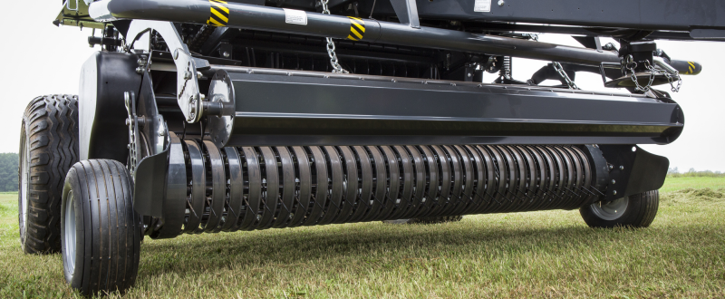
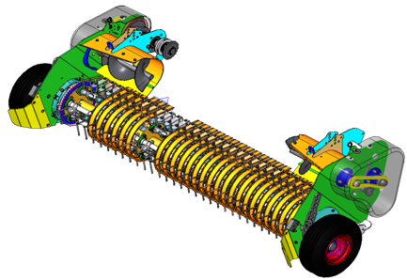
Pick-up
High capacity – Perfect raking
  Pick-up with 2.00m working width
    Feeder Fork
    1.66 from outer tines
    4 tine rows
  Pick-up with 2.20m working width
    DuoFeed and PowerFeed
    1.86 m from outer tines
    5 tine rows
  60 mm tine spacing
  Small diameter pick-up
  High rotation speed
High reliability
  Double cam drive (on 2.20m PU)
  Central bearing supports for tine bars
  Big diameter drive sprocket

Slide 8
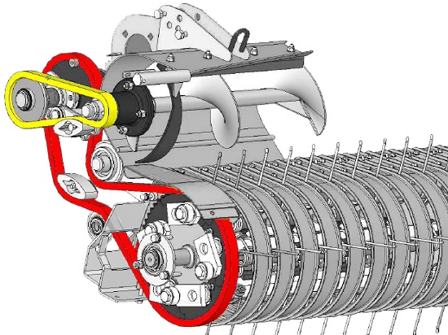
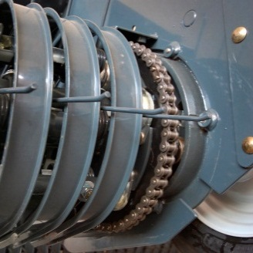
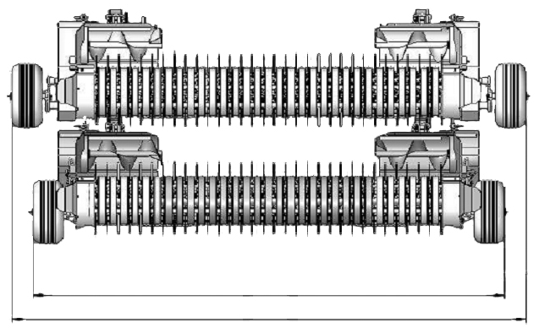
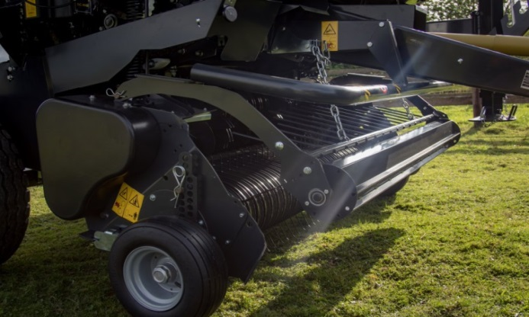
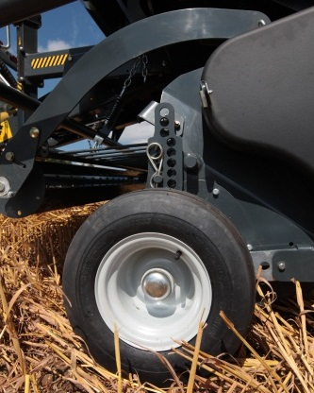
Pick-up
The narrowest transport width on the market
  Internal drive (unique feature - patented)
  2.545 m of transport width on 2.20 m PU
Complete standard features
  Crop deflector on 2.00 m PU
  Roller crop press on 2.20 m PU
  Adjustable pneumatic pick-up wheels
  Suspended on large springs
  Hydraulic lift
2545 mm

Slide 9
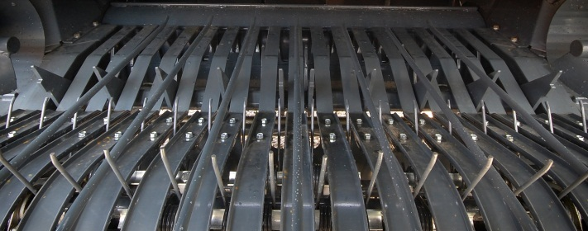
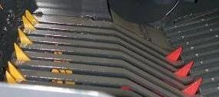
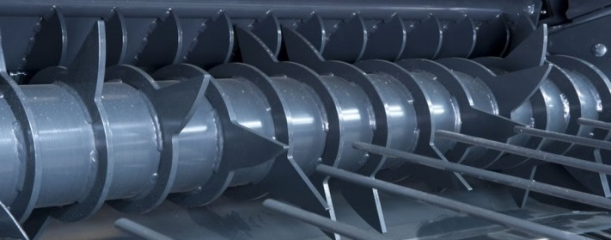
Feeding devices
3 different feeding devices available
  Feeder Fork
    Fork feeding device
  DuoFeed
    Double fork feeding device
  PowerFeed
    Rotor feeding

Slide 10
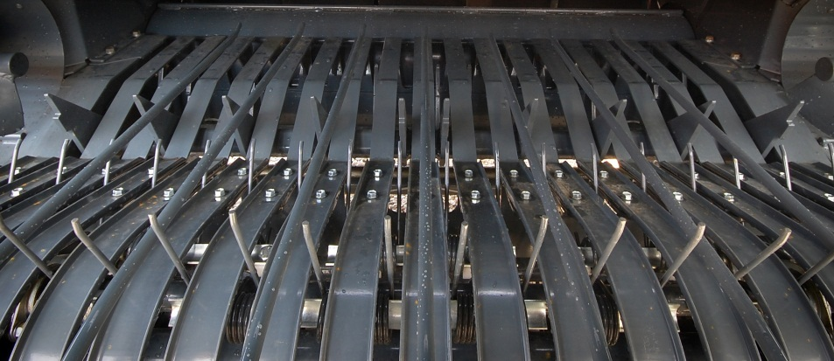
Feeder Fork
Simple and reliable
  Positive crop flow in all conditions
  Protection by cam clutch
  Fully counter balanced operation
Efficient in all conditions
  Twin aggressive augers bring the material to the center
  The material is smoothly pushed into the chamber
  System provides positive bale starting

Slide 11
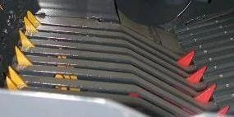
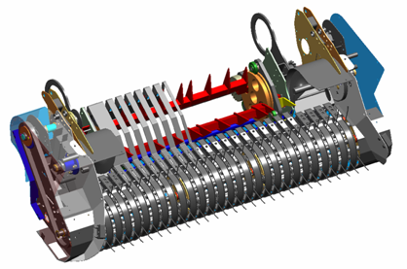
DuoFeed
Simple and reliable
  Double feeder fork system
  Patented
  Shearbolt protected
  Fully counter balanced operation
High capacity in all conditions
  The material is pushed into the chamber
  2 augers bring the material to the centre
  Positive bale start

Slide 12
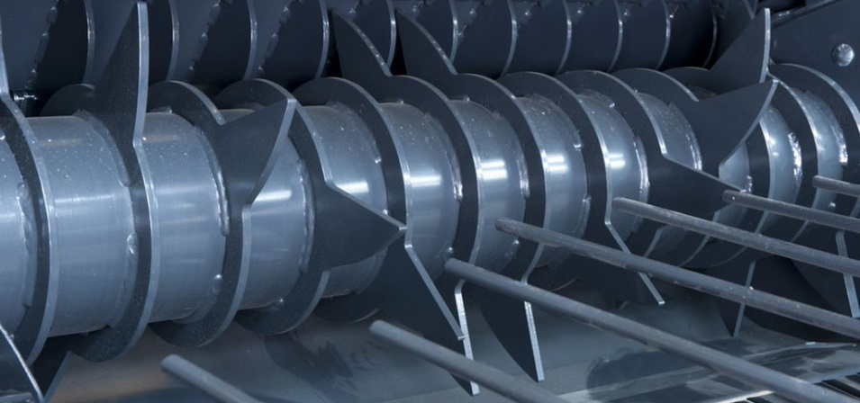
PowerFeed Rotor
Robust and reliable
  400 mm rotor diameter
  Very robust construction
  14 strong fully guided tines
High capacity in all conditions
  The material is forced into the chamber
  Instant bale start in all the conditions
  Design with opposite tines provides a very high intake capacity with all crops

Slide 13
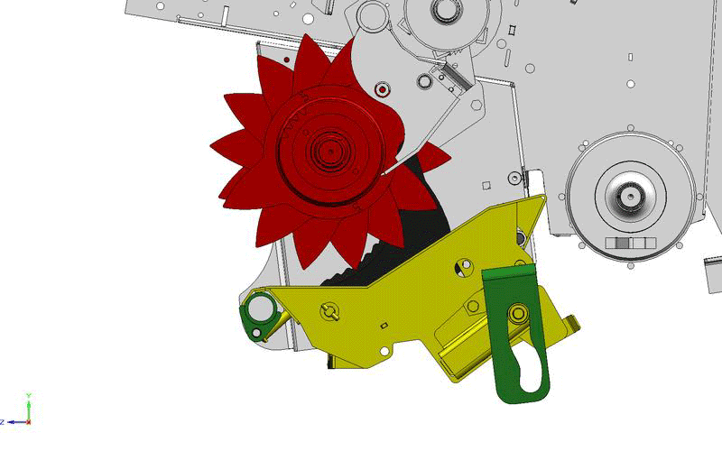
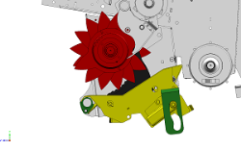
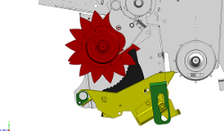
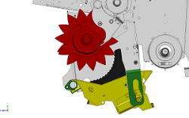
New DropFloor - unblocking strategy
Full comfort technology
  Operated directly from tractor cab
  Single acting valve needed
Fast and efficient rotor un-blocking device
  Fast operating system
    Select ‘DropFloor’ function on control box
    Remove the hydraulic pressure and re-engage PTO
    Pressure the system back and start baling again
A safe system to remove a blockage
  Increased clearance between floor and rotor thanks to new parallelogram system
  100% efficiency in clearing crop blockages

Slide 14
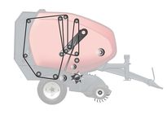
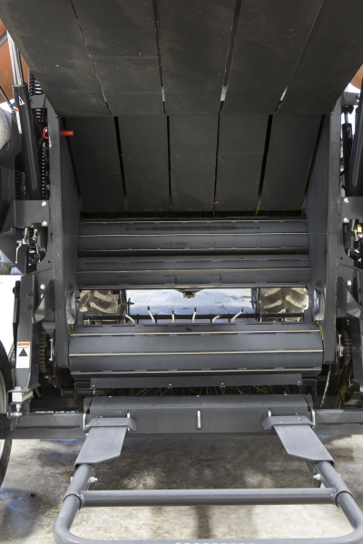
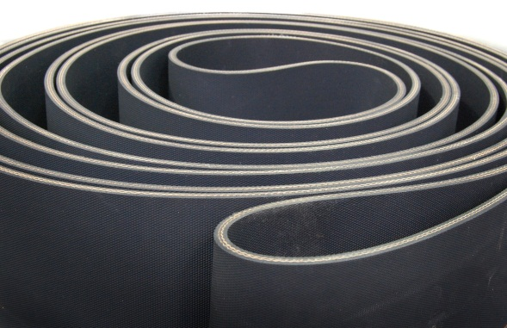
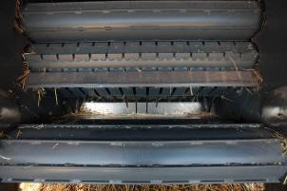
Bale Chamber
A soft core bale chamber
  Open pre-chamber concept
  3 rollers: 1 bottom, 2 front
  5 laced belts
    220mm width
    Double layer (0.23 ” thickness)
    Mato lacings
Perfect bale starting in all conditions
  Aggressive roller for better bale rotation
  Mixed core of the bale (belts & rollers)

Slide 15
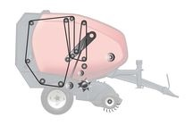
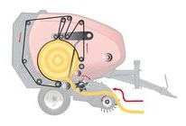
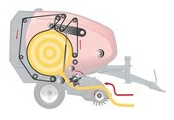
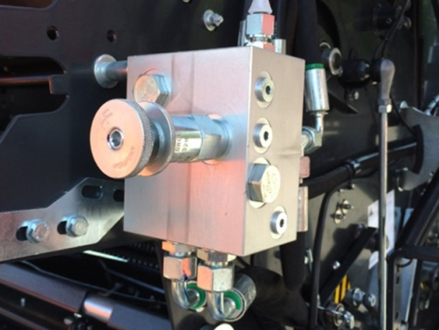
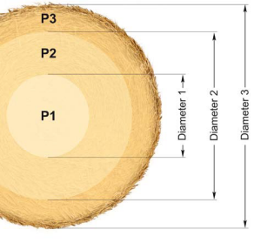
Density principle
Mechanical proportional density
  Hydraulic density control until 200 bars
  Mechanical tensioner arm with spring assistance
  As the bale diameter grows, the pressure increases
  Result is a regular density over the whole bale
Fully adjustable hydraulic density control (Optional)
  Density is controlled by manual valve (resulting on regular density)
  Optional proportional valve gives
    Control from cab
    3 core controls via Intelligent Density 3D
    Full control of bale shape according material type
    Increased weather protection

Slide 16
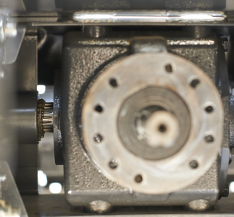
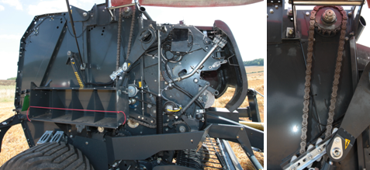
Heavy Duty Drive Line
High reliability & low maintenance
  Triple gearbox for stress reduction
  Strong roller shafts and bearings
  Eccentric roller bearing mountings
Secure drive line protection for baler
  PTO with shear bolt on F and FD versions
  PTO with cam clutch on R version

Slide 17
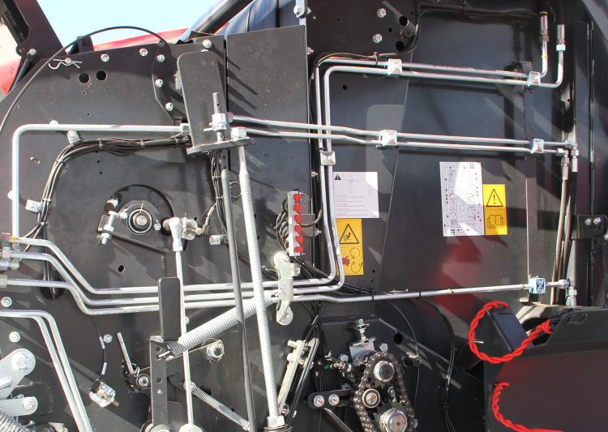
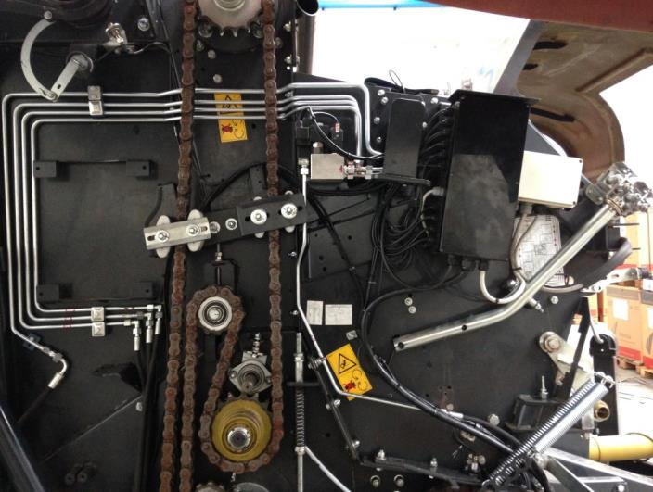
Hydraulics
Integration of steel pipes in hydr. circuit
  Better protection in critical area
  Professional approach
  Better visual impact

Slide 18
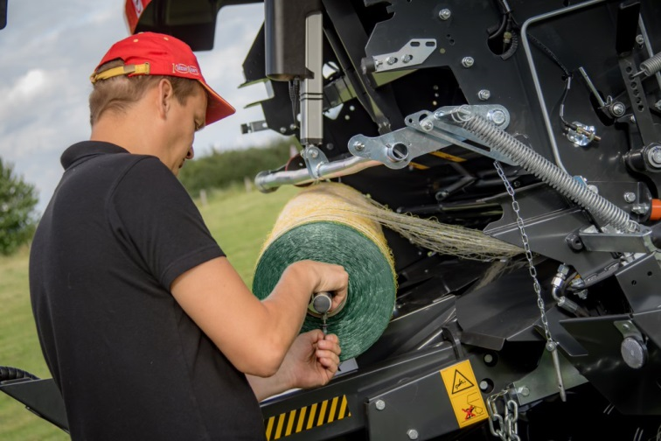
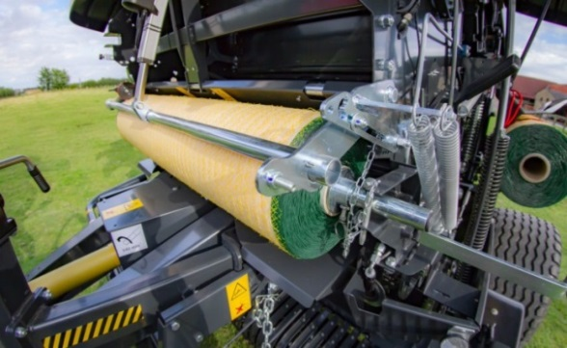
PowerBind Net Wrap System
Front mounted direct injection system for a sure start every time
Positive feed of net into the bale chamber
  Net permanently retained in injection arm, no time spent on first pick up of the net prior to injection
  No effect from windy conditions
  No feed rollers
  Very fast operation
Perfect net spread on the bale
  Net is going fully from side to side
  Edge covering net types can be used
Easy to operate device
  Maximum comfort for the user
    Perfect access to net loading area for servicing
    Fast and comfortable net roll changing and threading
    Fully programmable from control box in tractor cab
Storage for 2 spare net rolls

Slide 19
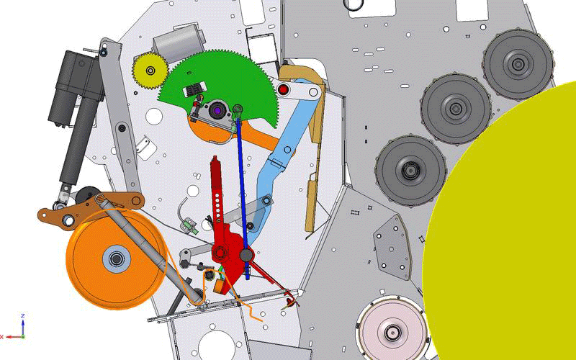
PowerBind Net Wrap System

Slide 20
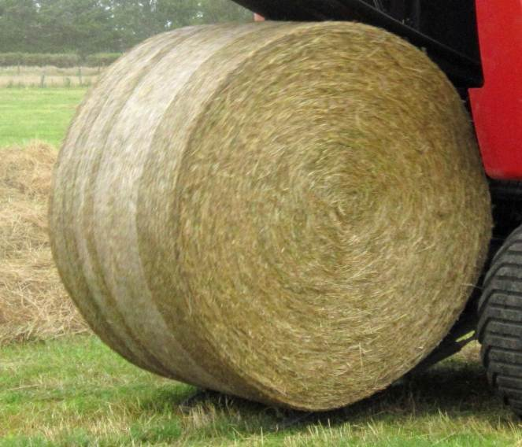
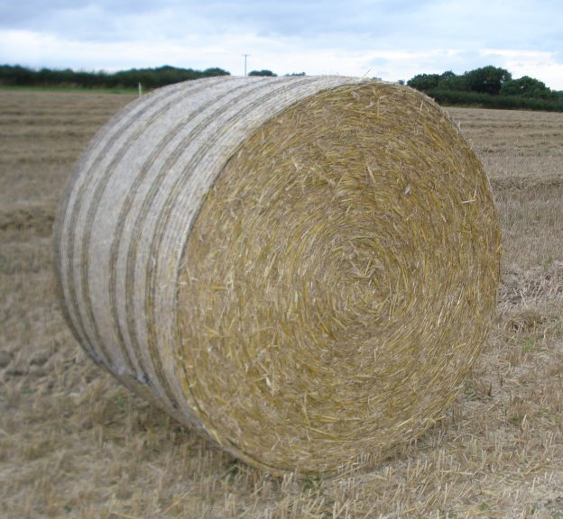
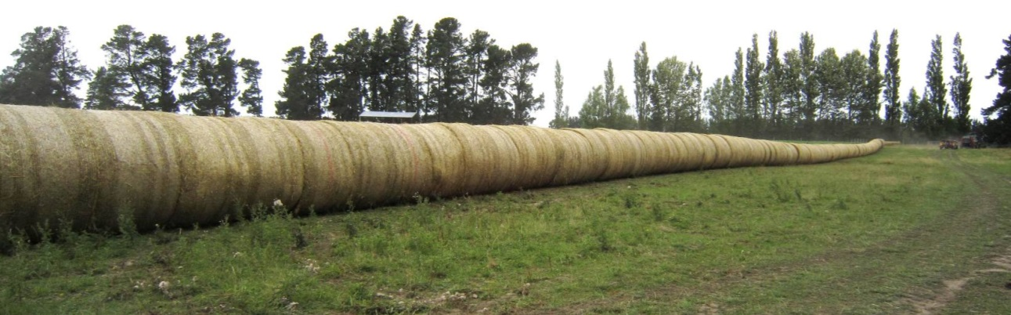
PowerBind Net Wrap System
Great looking bales in all crops
  Fantastic shape
  Consistent diameter
  Net to edge of bale
  Bales stack and transport well

Slide 21
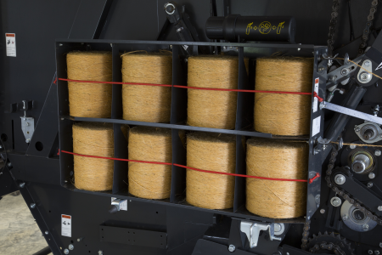


PowerBind Twine System
Perfect twine spacing
  2 Twine arms each cover half the bale
  Cycle starts at the side and finishes in the centre – eliminating loose ends
Efficient and fast operating system
  Forced injection for efficient twine start
  Fast cycle time for improved productivity
  Brake released during injection
  Over-braking during side binding
Easy to operate device
  Easy access to twine boxes
  Simple twine route
  Full control from tractor
Storage for 8 twine bobbins

Slide 22

PowerBind Twine System

Slide 23

Controls - Focus
Simplicity – Efficiency – Productivity
  Easy to use control system
  Intuitive access to all functions
Full control on board
  Bale diameter adjustment
  Current bale diameter (bale growing)
  Density adjust (option proportional valve)
  Left & Right handside indicators
  Twine or net tying selection
  Twine and net tying adjustment
  Tying information during cycle
  Manual or automatic tying mode selection
  Bale counter that can save up to 40 bale counts
  Hydraulic selection control
    Pick-up, DropFloor, Knives
  Productivity information (bales per hour)

Slide 24

IsoBus Technology (optional)
IsoMatch Tellus GO* - compact ISOBUS Terminal
Full IsoBus terminal
Compact design:
  Easy to integrate in the tractor cab
  7-inch touch screen for perfect machine set-up and control
Hard keys combined with rotary-switch
  Direct access to main functions
  Optimal use while driving
Implement control has never been so easy
* These full ISO terminals can be fitted on the new fixed chamber baler line, provided units are ordered from factory with Isobus connection kit.

Slide 25




The 5 Arguments, Gallignani GV416 – GV418 S Line
1
Small diameter pick-up design with 2.0 or 2.2m working width.
2
Cost efficient Fork Feeder (single or double) or high capacity PowerFeed rotor with DropFloor.
3
Variable chamber concept with maximum bale diameters of 1.65m or 1.80m providing bales with a moderate core and tight outer layer.
4
PowerBind: New accurate and dependable net and twine injection – net is injected in a flat movement to ensure reliable net injection under all conditions.
5
Simple and intuitive control with the Focus terminal. All functions are shown on a large, clear digital display.

Slide 26


Gallignani GV516-520 ProLine
High Performance Variable Chamber Balers

Slide 27

Gallignani GV516 – 520 ProLine
Overview
PIC. GV516 ProLine
Model | Bale Diameter | Intake | Binding
GV516 R | 1.2 x 0.6-1.65m | PowerFeed Rotor | Twine, Net, Double
GV516 SC-14 | 1.2 x 0.6-1.65m | SuperCut-14 | Net, Double
GV516 SC-25 | 1.2 x 0.6-1.65m | SuperCut-25 | Net
GV520 R | 1.2 x 0.6-2.00m | PowerFeed Rotor | Twine, Net, Double
GV520 SC-14 | 1.2 x 0.6-2.00m | SuperCut-14 | Net, Double
GV520 SC-25 | 1.2 x 0.6-2.00m | SuperCut-25 | Net

Slide 28



Highlights
Intake System
Intelligent Density 3D
High capacity PowerFeed rotor or SuperCut with 14 or 25 knives
New DropFloor
Efficient rotor unblocking device
3 different pre-set bale densities to suit main types of crops for easy selection from cab.
ISOBUS Terminals
Easy Netting
Easy and simple
loading of net rolls for
full operator’s comfort
GV500 series is fully ISOBUS compliant. Terminals are optional equipment.
PowerBind
New net and twine
binding system

Slide 29
General specifications
Chamber concept: mixed chamber (full versatility for multi crop baling)
Bale size
  1.20 m x 0.60 to 1.65 m on GV516
  1.20 m x 0.60 to 2.00 m on GV520
Feeding device - Pick-up:
  Rotor + drop floor ➔ PU 2.20 m + wheels + roller crop press
  SC14 knives + drop floor ➔ PU 2.20 m + wheels + roller crop press
  SC25 knives + drop floor ➔ PU 2.20 m + wheels + roller crop press
PowerBind with following binding options
  Twine Not on SC
  Net
  Double (net & twine) Not on SC25
Full IsoBus compatibility - Focus or IsoMatch Tellus GO or Tellus control terminals optional
Proportional valve standard
W-A PTO shaft with Cam Clutch
Wheels: 15/55-17
Greasable roller bearings with centralised greasing banks
Automatic chain lubrication
Tear drop plate

Slide 30

Pick-up
High capacity – Perfect raking
  Pick-up with 2.20m working width
    1.86 m from outer tines
    5 tine rows
  60 mm tine spacing
  Small diameter pick-up
  High rotation speed
High reliability
  Double cam drive (on 2.20m PU)
  Central bearing supports for tine bars
  Big diameter drive sprocket

Slide 31
Pick-up
The narrowest transport width on the market
  Internal drive (unique feature - patented)
  2.545 m of transport width on 2.20 m PU
Complete standard features
  Roller crop press on 2.20 m PU
  Adjustable pneumatic pick-up wheels
  Suspended on large springs
  Hydraulic lift
2545 mm

Slide 32


Feeding devices
3 different feeding devices available
  PowerFeed
    Rotor feeding device
  SuperCut-14
    Cutting device with 14 knives
  SuperCut-25
    Cutting device with 25 knives

Slide 33
PowerFeed rotor
Robust and reliable
  400 mm rotor diameter
  Very robust construction
  14 fully guided tines
High capacity in all conditions
  The material is forced into the chamber
  Instant bale start in all the conditions
  Design with opposite tines provides a very high intake capacity with all crops

Slide 34

SuperCut 14-knife cutting device
Reliable cutting device
  400 mm rotor diameter
  14 fully guided double tines
  14 knives controlled from tractor cab
  70 mm theoretical cutting length
High capacity in all conditions
  The material is forced into the chamber through the knives
  Instant bale start in all conditions
  Design with opposite tines provides a very high intake capacity
  DropFloor
Perfect cutting quality
  Hardened knives
  Individually spring-protected knives
  Automatic knife re-engagement

Slide 35


SuperCut 25-knife cutting device
A powerful cutting device
  400 mm rotor diameter
  25 strong full guided double tines
  25 knives controlled from tractor cab
  4 group selections: 6-12-13-25
High capacity in all conditions
  The material is forced into the chamber through the knives
  Instant bale start in all the conditions
  Design with opposite tines provides a very high intake capacity even with 25 knives engaged
  DropFloor
Perfect cutting quality
  Hardened knives
  Individually double spring protected knives
  Automatic knife re-engagement

Slide 36



SuperCut 25-knife cutting device
Strong, unique features
  High flexibility in crops and working conditions thanks to the knife group selection (6, 12, 13 or 25)
  A perfect cutting quality thanks to the double knife protection (patented)
    First protection allows knife to move backwards: knife keeps its cutting effect (small obstacle)
    Second protection allows knife to move down: knife fully down for maximum clearance (large obstacle)
2
1

Slide 37
New DropFloor - unblocking strategy
Full comfort technology
  Operated directly from tractor cab
  Single acting valve needed
Fast and efficient rotor un-blocking device
  Fast operating system
    Select ‘DropFloor’ function on control box
    Remove the hydraulic pressure and re-engage PTO
    Pressure the system back and start baling again
A safe system to remove a blockage
  Increased clearance between floor and rotor thanks to new parallelogram system
  100% efficiency in clearing crop blockages

Slide 38



Bale Chamber
Chamber design with reduced critical areas
for crop build up in wet conditions
Instant crop rotation
  3 rollers: 1 ribbed bottom, 2 Profiled fronts
  5 endless belts
  220mm wide
  Triple layer (0.31” thickness)
Good bale start in all conditions
  Two profiled rollers ensure instant bale rotation
  High bale density due to immediate rolling and pressurizing

Slide 39


Intelligent Density 3D
Mechanical proportional density
  Hydraulic density control until 200 bars
  Mechanical tensioner arm with spring assistance
  As the bale diameter grows, the pressure increases
  Result is a regular density over the whole bale
Intelligent Density 3D
  3 pre-set bale density settings, for easy and quick adaptation to crop conditions
  3 different zones (3 diameters & 3 pressures) adjustable
  Pre-set binding cycles linked with each density setting
  Full control of bale structure from tractor seat
  0-bar function allows soft centre bale to be produced if required

Slide 40

Intelligent Density 3D
Easy setting of bale density
3 preselected options
  Straw
  Hay
  Silage
Still possible to customize bale density in 3 zones.

Slide 41

Intelligent Density 3D
Intelligent Density 3D
Baling dry straw and want the heaviest bales possible?
Maximum pressure is set in every zone.
Baling hay?
Soft center core to let the bale breathe is set, with gradually increasing pressure towards the outer layer.
Baling silage?
Reduced pressure settings to suit wetter crop conditions.

Slide 42


Drive Line
Heavy duty split driveline
  Bale chamber driven from right hand side
  Rotor driven from left hand side
  1¼" Pitch bale chamber drive chain
High reliability & low maintenance
  Automatic chain lubrication
  Remote greasable bearings on fixed rollers
  Strong rollers shafts and bearings
  Eccentric roller bearing mountings
Secure protection of the baler
  Cam clutch protection on PTO shaft
  Cam clutch protection on pick-up

Slide 43
Hydraulics
Integration of steel pipes in hydr. circuit
  Better protection in critical area
  Professional approach
  Better visual impact

Slide 44
PowerBind Net Wrap System
Front mounted direct injection system for a sure start every time
Positive feed of net into the bale chamber
  Net permanently retained in injection arm, no time spent on first pick up of the net prior to injection
  No effect from windy conditions
  No feed rollers
  Very fast operation
Perfect net spread on the bale
  Net is going fully from side to side
  Edge covering net types can be used
Easy to operate device
  Maximum comfort for the user
    Perfect access to net loading area for servicing
    Fast and comfortable net roll changing and threading
    Fully programmable from control box in tractor cab
Storage for 2 spare net rolls

Slide 45
PowerBind Net Wrap System

Slide 46
PowerBind Net Wrap System
Great looking bales in all crops
  Fantastic shape
  Consistent diameter
  Net to edge of bale
  Bales stack and transport well

Slide 47
PowerBind Twine System
Perfect twine spacing
  2 Twine arms each cover half the bale
  Cycle starts at the side and finishes in the centre – eliminating loose ends
Efficient and fast operating system
  Forced injection for efficient twine start
  Fast cycle time for improved productivity
  Brake released during injection
  Over-braking during side binding
Easy to operate device
  Easy access to twine boxes
  Simple twine route
  Full control from tractor
Storage for 8 twine bobbins

Slide 48
PowerBind Twine System

Slide 49



Full ISOBUS Compatibility
Simplicity – Efficiency – Productivity
  Choose between Focus, IsoMatch Tellus GO or IsoMatch Tellus terminals
  Plug in directly to an ISO compatible tractor display in a few seconds
  Very easy to use interface
Full control on board
  Bale diameter adjustment
  Density adjustment in three zones
  Current bale diameter (bale growing)
  Left/Right driving indicator
  Selection of twine or net binding
  Adjustment of twine and net binding cycles Manual or automatic binding start
  Total bale counter & 40 field counters
  Selection of pick-up, drop floor & knives
  Performance monitor (bales per hour)
AGCO
CNH

Slide 50



The 5 Arguments, Gallignani GV516 – GV520 ProLine
1
2.2m pick-up with small diameter for fast and efficient throughput.
2
PowerFeed rotor, SuperCut 14 or 25 knives and DropFloor for easy unblocking
3
Intelligent Density 3D for quick and easy adaptation to balind and crop conditions. Multi-crop baler for use in silage, hay and straw.
4
PowerBind: New accurate and dependable net and twine injection – net is injected in a flat movement to ensure reliable net injection under all conditions.
5
Fully ISOBUS compatible. Plug in to ISO tractor terminal or choose from an ample range of terminals (for instance, IsoMatch Tellus terminal with 12” screen and 2 interface screens.

