Slide 1
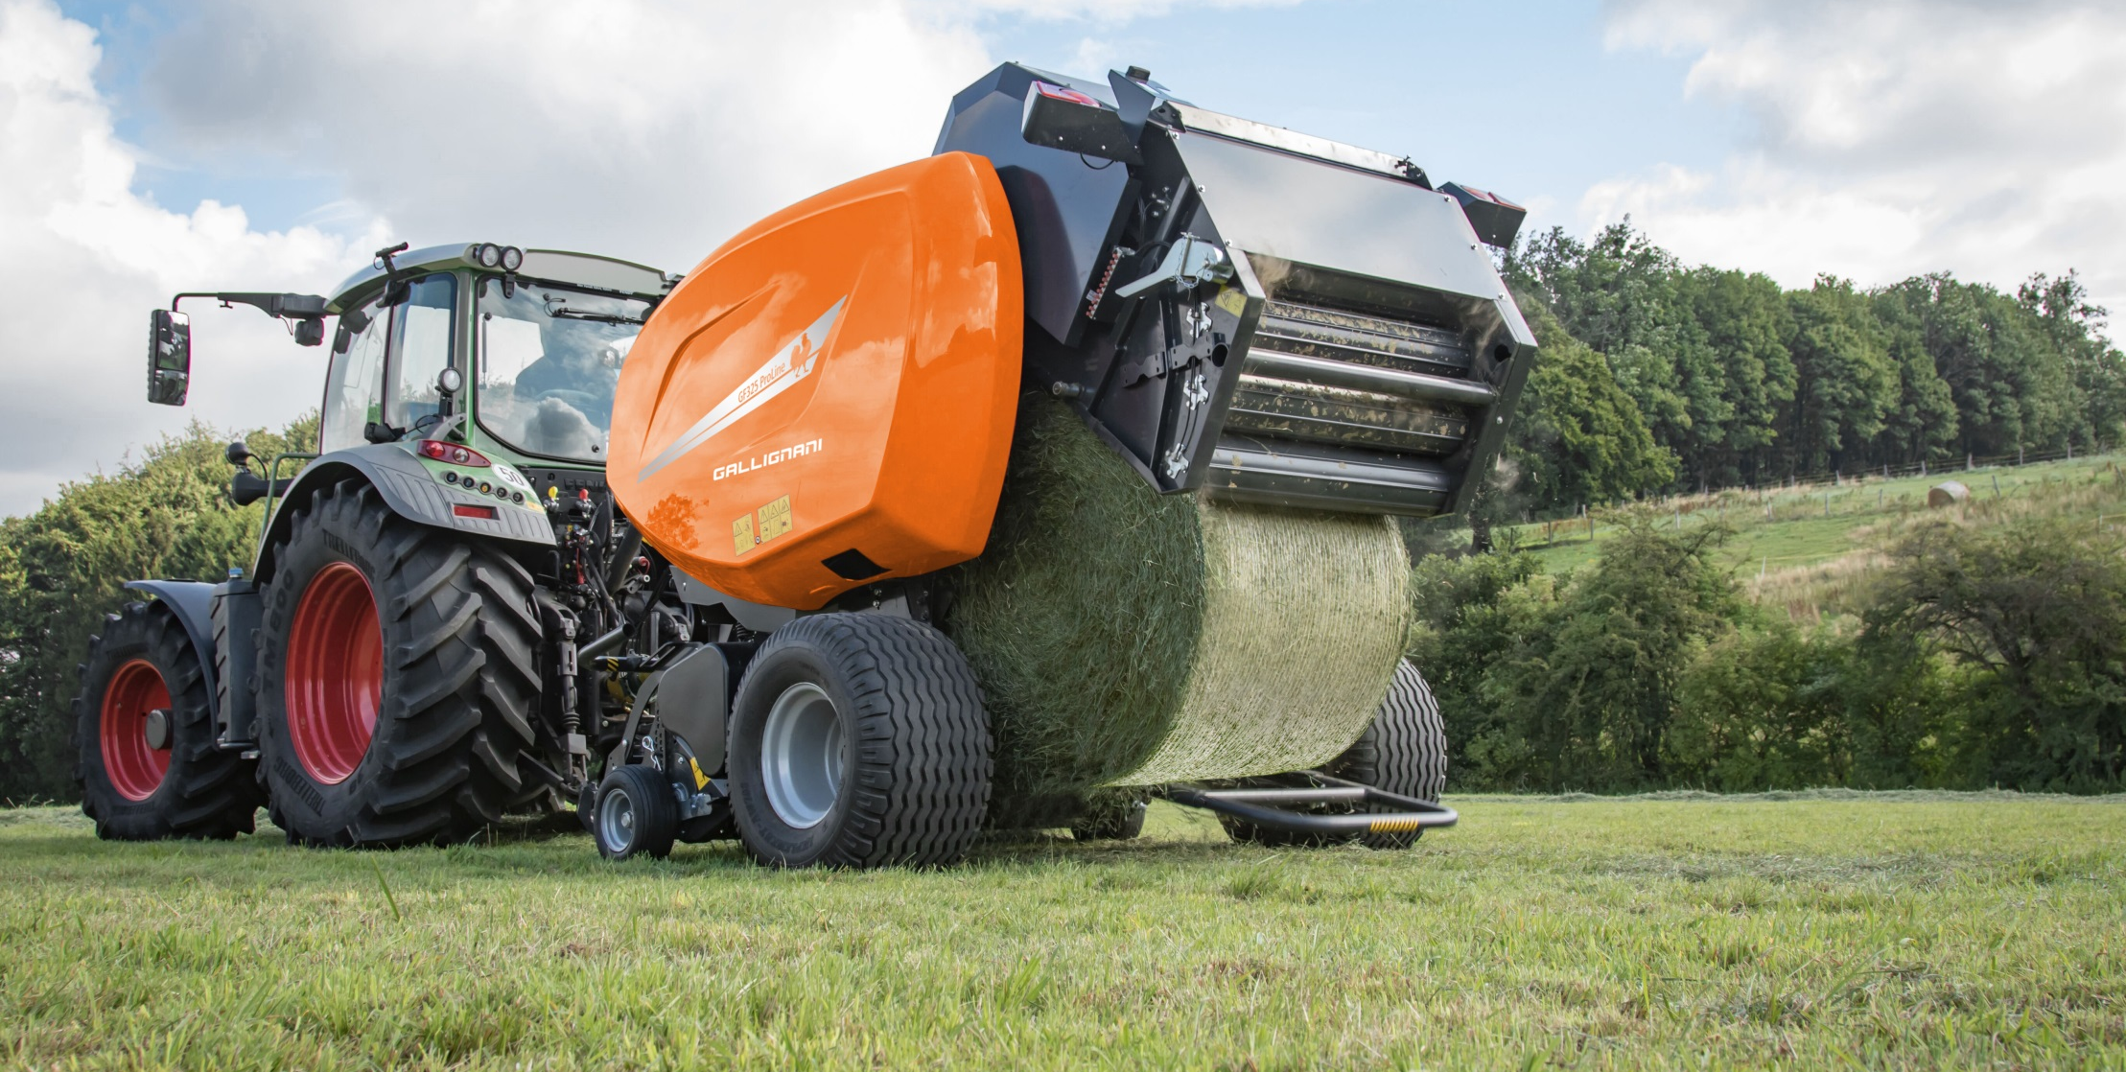
Gallignani Fixed Chamber Round Balers
Product Information 2016

Slide 2
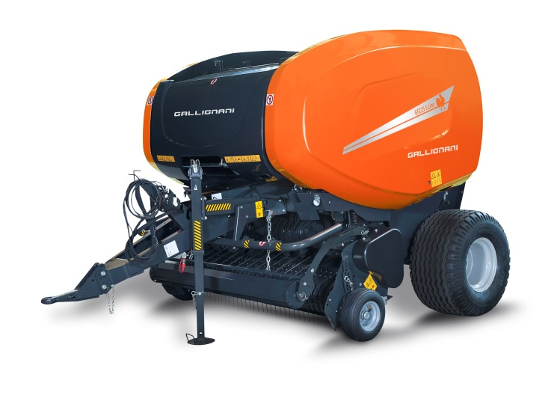

GF225 - GF255
S-Line/ProLine
GF325
ProLine

Slide 3
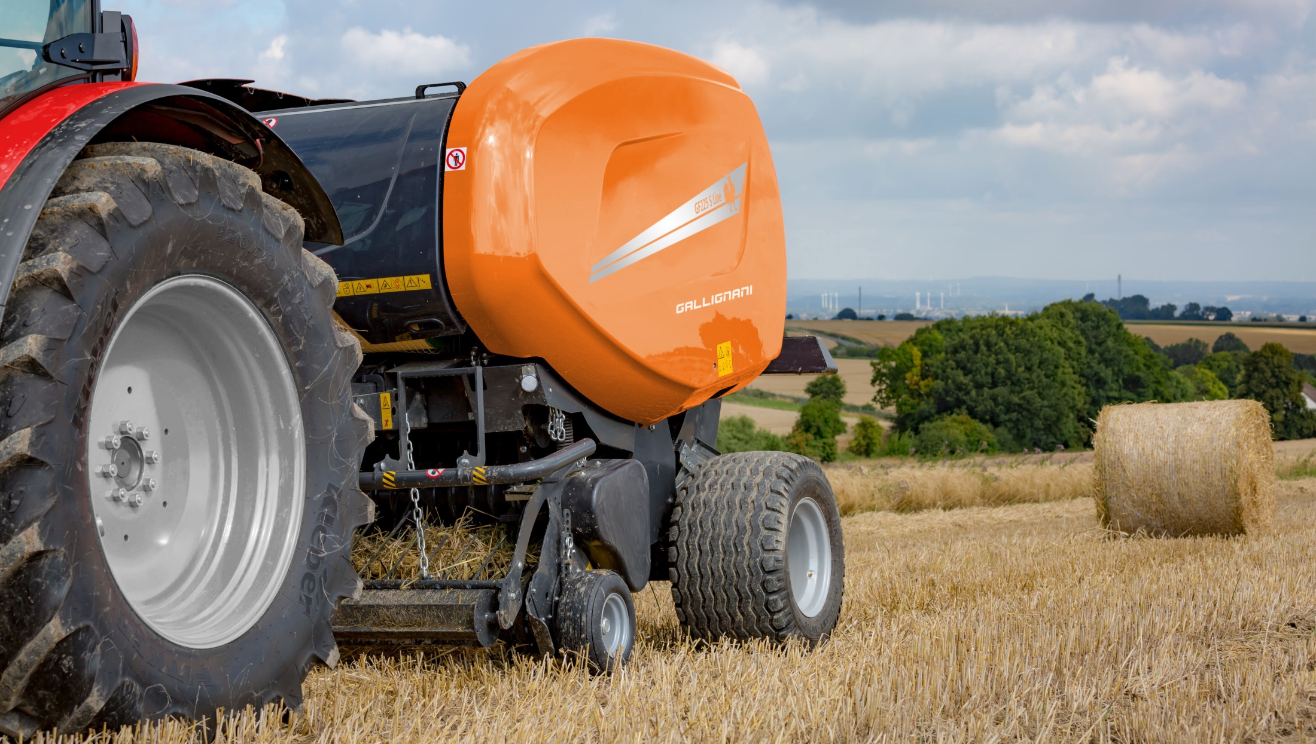
Gallignani GF225-GF255 S-Line & ProLine

Slide 4

Gallignani GF225
Overview
Model | Bale Diameter | Intake | Binding
GF225 F S-Line | 1.20x1.25m | Feeder fork | Twine, Net, Double
GF225 R S-Line | 1.20x1.25m | PowerFeed Rotor | Twine, Net, Double
GF225 SC-14 S-Line | 1.20x1.25m | SuperCut | Net or Double

Slide 5
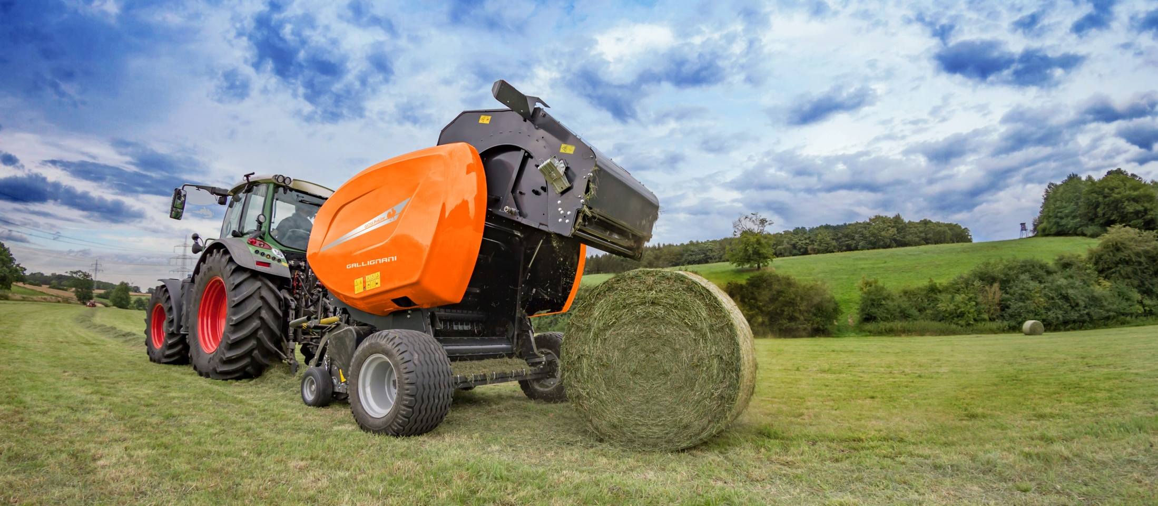
Gallignani GF255
Overview
Model | Bale Diameter | Intake | Binding
GF255 F S-Line | 1.20x1.55m | Fork Feeder | Twine, Net, Double
GF255 FD S-Line | 1.20x1.55m | DuoFeed fork | Net, Double
GF255 SC-14 ProLine | 1.20x1.55m | SuperCut | Net

Slide 6
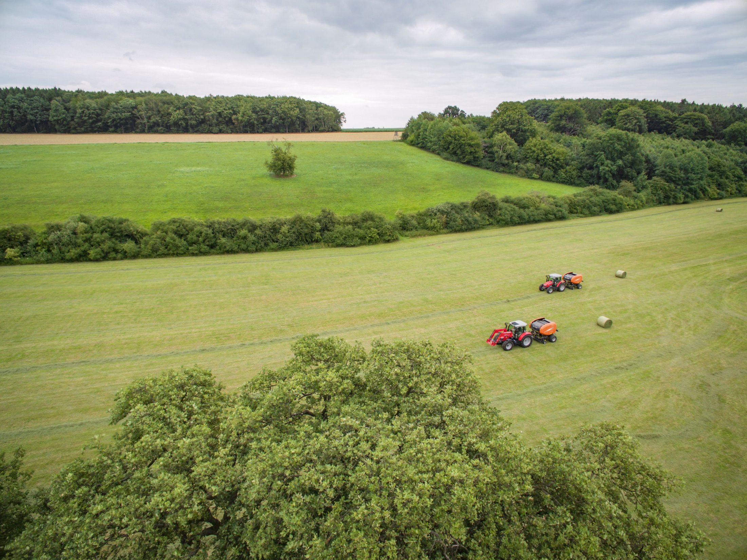
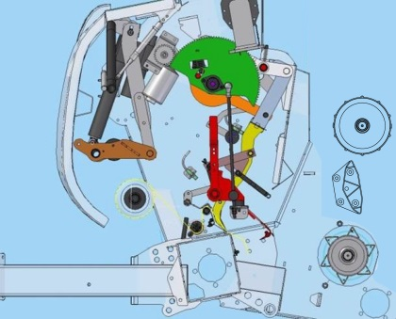
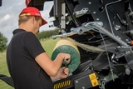
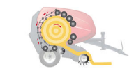
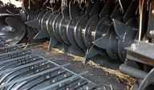
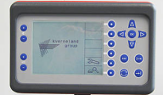
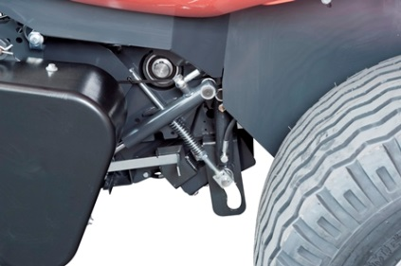
Highlights
PowerBind
New net and twine
binding system
Easy Netting
RotaMax chamber
Rollers and Chain/slats bale chamber for excellent crop handling in all conditions
Easy and simple loading of net rolls for full operator’s comfort.
Focus Terminal
Intake systems
Fork Feeder or high capacity PowerFeed rotor or SuperCut 14
DropFloor
New parallelogram
system for excellent
crop clearing
Simple and intuitive Focus control terminal

Slide 7
General specifications GF225
Chamber concept: rollers on front, chains & slats on the rear
Bale size
  1.20 m x 1.25 m
Machine designed for maximum flexibility in all crops
Feeding device - Pick-up:
  Feeder fork ➔ PU 2.00 m + wheels + crop deflector
  Rotor ➔ PU 2.00 m + wheels + roller crop press
  SC with 14 knives + drop floor ➔ PU 2.20 m + wheels + roller crop press
PowerBind with following binding options
  Twine Not on SC
  Net
  Double (net & twine)
Control box
  Focus
W-A PTO shaft ➔ Shear bolt on F version ➔ Cam clutch on R & SC
Wheels ➔ 11.5/80-15 on F & R versions ➔ 15.0/55-17 on SC
Automatic chain lubrication
Steel pipes on hydraulic system

Slide 8
General specifications GF255
Chamber concept: rollers on front, chains & slats on the rear
Bale size
  1.20 m x 1.55 m
Machine designed for maximum flexibility in all crops
Feeding device - Pick-up:
  Feeder fork ➔ PU 2.00 m + wheels + crop deflector
  DuoFeed fork ➔ PU 2.20 m + wheels + crop deflector
  SC with 14 knives + drop floor ➔ PU 2.20 m + wheels + roller crop press
PowerBind with following binding options
  Twine Not on SC and FD
  Net
  Double (net & twine)
Control box
  Focus
W-A PTO shaft ➔ Shear bolt on F & FD versions ➔ Cam clutch on SC
Wheels ➔ 11.5/80-15 on F & FD versions ➔ 15.0/55-17 on SC
Automatic chain lubrication
Steel pipes on hydraulic system

Slide 9
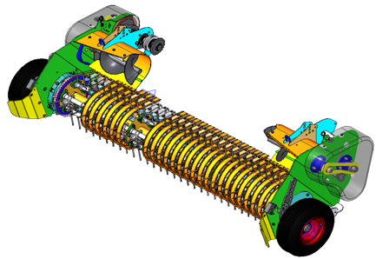
Pick-up
High capacity – Perfect raking
  Pick-up with 2.00m working width
    Feeder Fork and Power Feed
    1.66 from outer tines
    4 tine rows
  Pick-up with 2.20m working width
    SuperCut-14
    1.86 m from outer tines
    5 tine rows
  60 mm tine spacing
  Small diameter pick-up
  High rotation speed
High reliability
  Double cam drive (on 2.20m PU)
  Central bearing supports for tine bars
  Big diameter drive sprocket

Slide 10
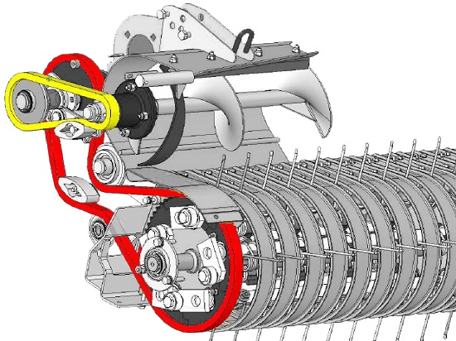
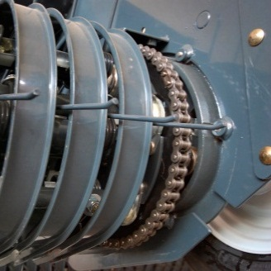
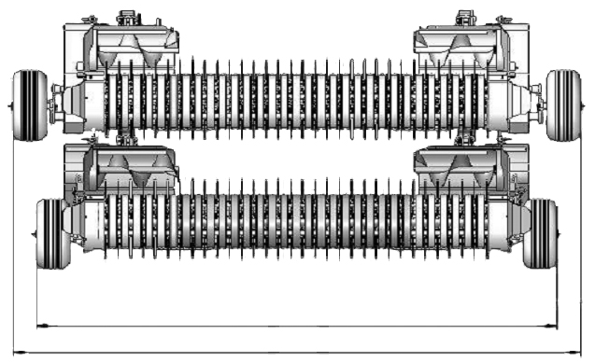
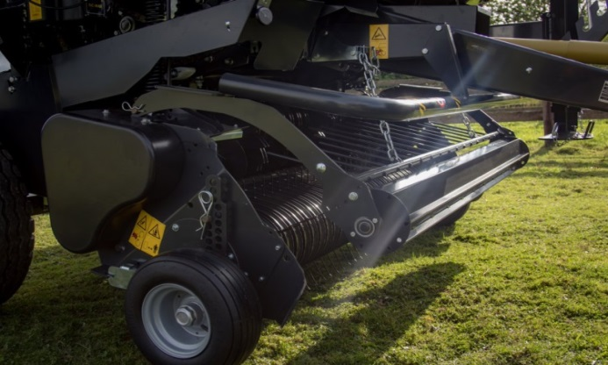
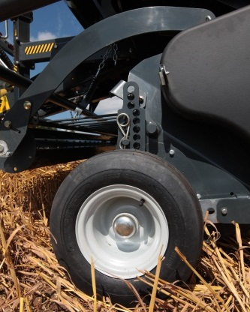
Pick-up
The narrowest transport width on the market
  Internal drive (unique feature - patented)
  2.545 m of transport width on 2.20 m PU
Complete standard features
  Crop deflector on 2.00 m PU (F)
  Roller crop press on 2.00 m PU (R) and 2.20 m PU
  Adjustable pneumatic pick-up wheels
  Suspended on large springs
  Hydraulic lift
2545 mm

Slide 11
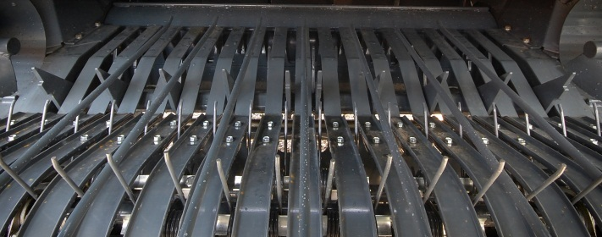
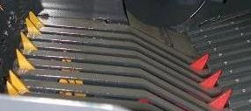
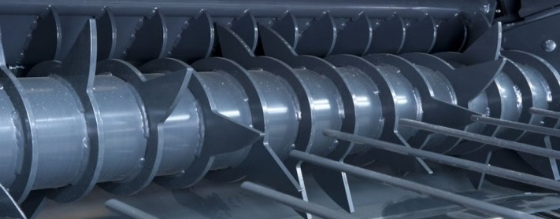
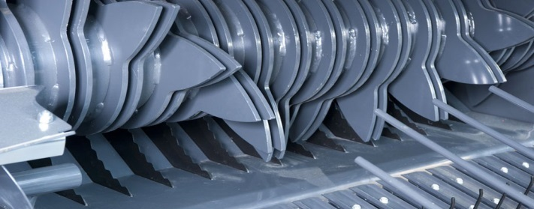
Feeding devices
4 different feeding devices available
  Feeder Fork (GF225 F & GF255 F)
    Fork feeding device
  DuoFeed (GF255 FD)
    Double fork feeding device
  PowerFeed (GF225 R)
    Rotor feeding device
  SuperCut-14 (GF225 SC)
    Cutting device with 14 knives

Slide 12
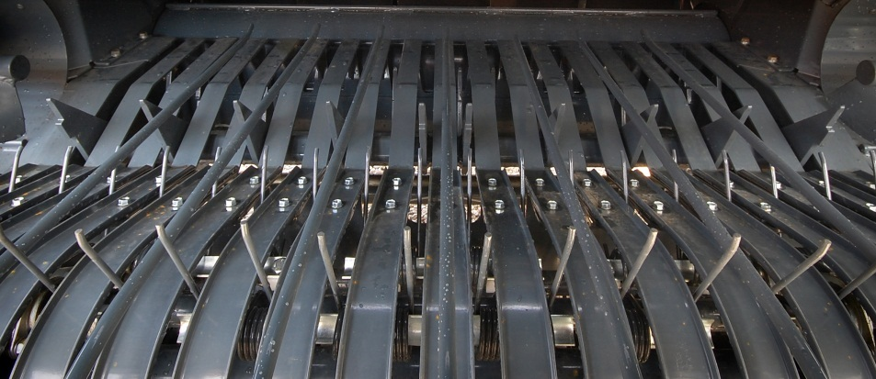
Feeder Fork
Simple and reliable
  Positive crop flow in all conditions
  Protection by cam clutch
  Fully counter balanced operation
Efficient in all conditions
  Twin aggressive augers bring the material to the center
  The material is smoothly pushed into the chamber
  System provides positive bale starting

Slide 13
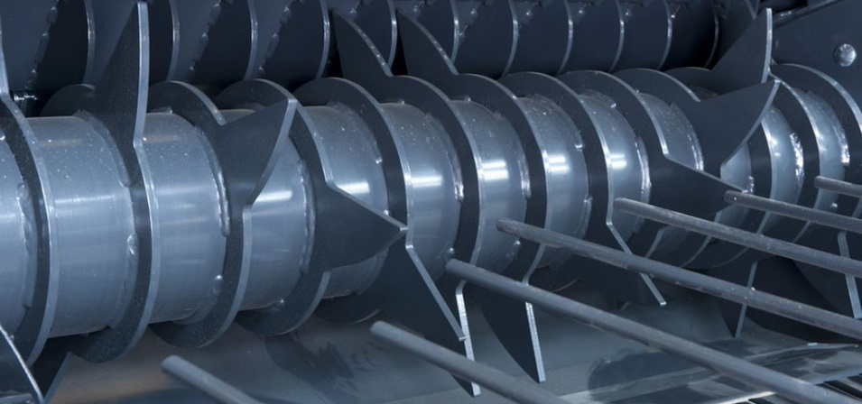
PowerFeed Rotor
Robust and reliable
  400 mm rotor diameter
  Very robust construction
  14 strong fully guided tines
High capacity in all conditions
  The material is forced into the chamber
  Instant bale start in all the conditions
  Design with opposite tines provides a very high intake capacity with all crops

Slide 14
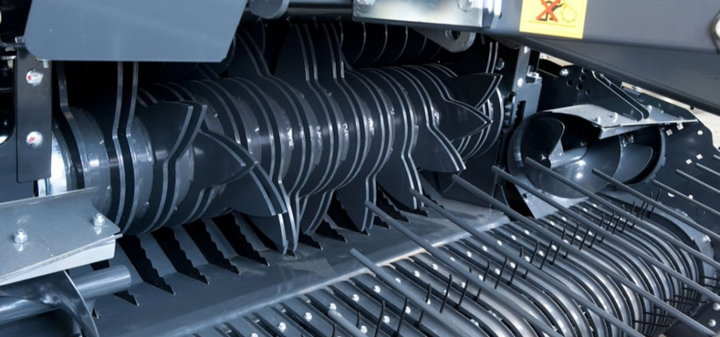
SuperCut 14-knife cutting device
Reliable cutting device
  400 mm rotor diameter
  14 fully guided double tines
  14 knives controlled from tractor cab
  70 mm theoretical cutting length
High capacity in all conditions
  The material is forced into the chamber through the knives
  Instant bale start in all conditions
  Design with opposite tines provides a very high intake capacity
  DropFloor
Perfect cutting quality
  Hardened knives
  Individually spring-protected knives
  Automatic knife re-engagement

Slide 15
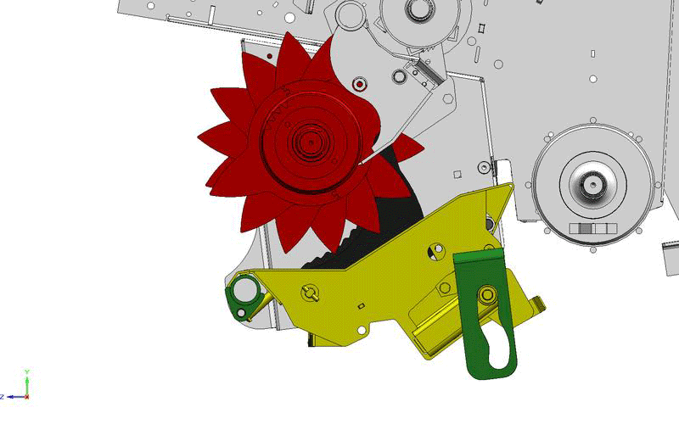
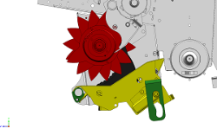
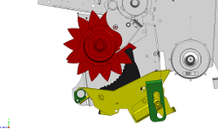
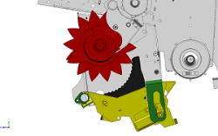
New DropFloor - unblocking strategy
Full comfort technology
  Operated directly from tractor cab
  Single acting valve needed
Fast and efficient rotor un-blocking device
  Fast operating system
    Select ‘DropFloor’ function on control box
    Remove the hydraulic pressure and re-engage PTO
    Pressure the system back and start baling again
A safe system to remove a blockage
  Increased clearance between floor and rotor thanks to new parallelogram system
  100% efficiency in clearing crop blockages

Slide 16
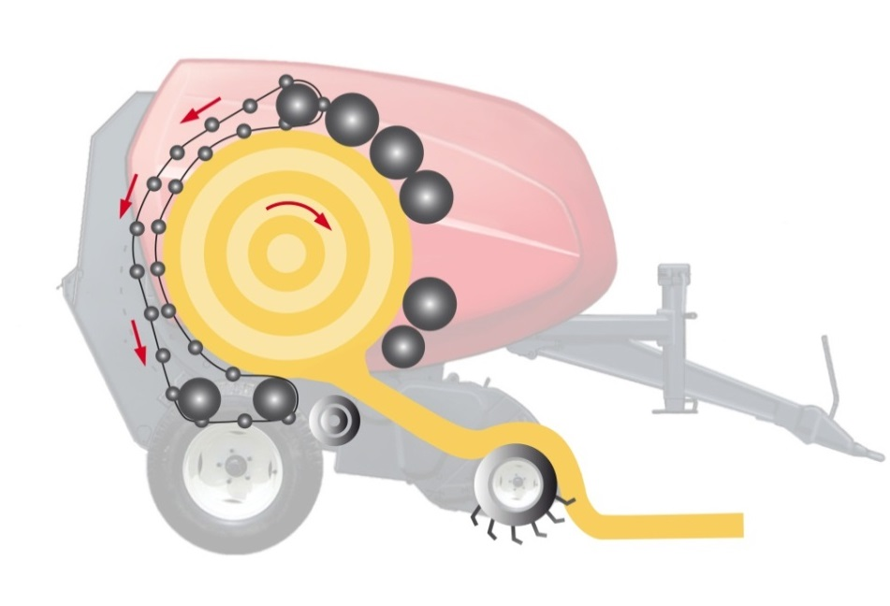
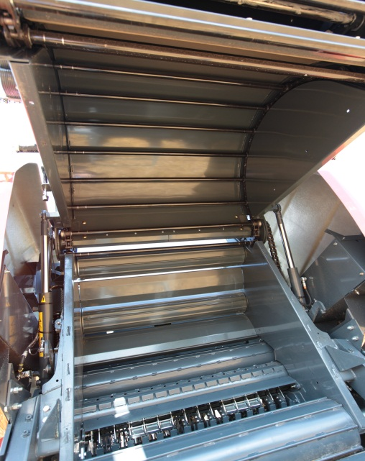
RotaMax bale chamber
A real versatile machine
  Mixed chamber concept
    5/7 rollers in the front
    Chains and slats in the tailgate
  Maximum flexibility
    Baling in all conditions
    Baling all type of crops
A perfect grip on bales
  Chains and slats provide a smooth and reliable bale rotation in extreme conditions
    16 slats (+ chains) on Feeder Fork model
    24 slats (+ chains) on PowerFeed and SC models
    28 slats on GF255 models
A high density and good bale shape
  Rollers at the front increase density and contribute to a better bale shape

Slide 17
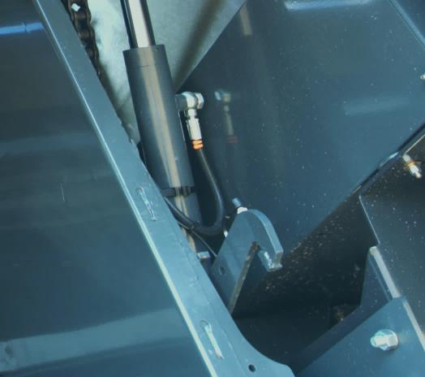
Locking device - Density
Mechanical locking device
High density bales
  Powerful tailgate locking
  Density setting controlled from tractor cab
High reliability of the baler
  Simple mechanical concept
  Maintenance free system
  Strong locking for less stress on tailgate
  No risk of oil leakage

Slide 18
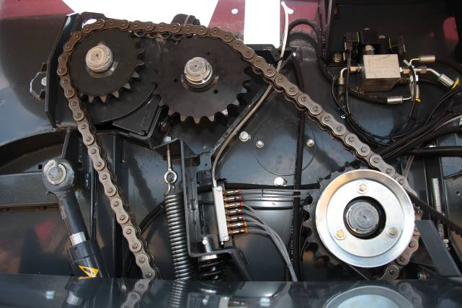
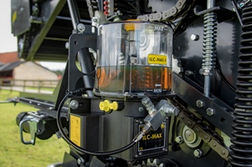
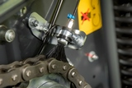
Drive line - Cinematic
Heavy duty driveline
  Split driveline with
    Bale driving on right hand side
    Rotor driving on left hand side
  Strong 1’ ¼ pitch main drive chain
High reliability & low maintenance
  Automatic chain lubrication
  Strong roller shafts and bearings
  Eccentric roller bearings mounting
A secure protection of the baler
  Protection on PTO shaft
    Shear bolt on Feeder Fork
    Cam clutch on PowerFeed and SuperCut

Slide 19
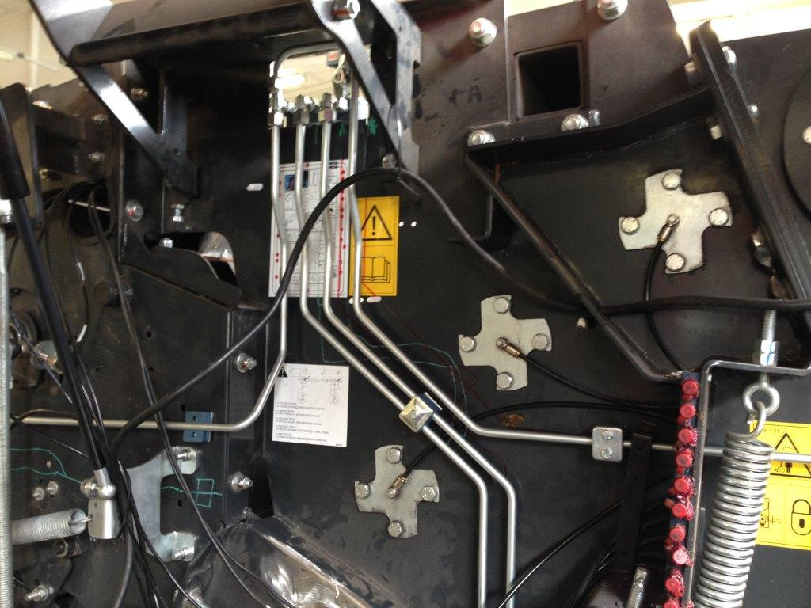
Hydraulics
Integration of steel pipes in the hydraulic circuit
  Better protection of critical area
  Professional approach
  Better visual impact

Slide 20
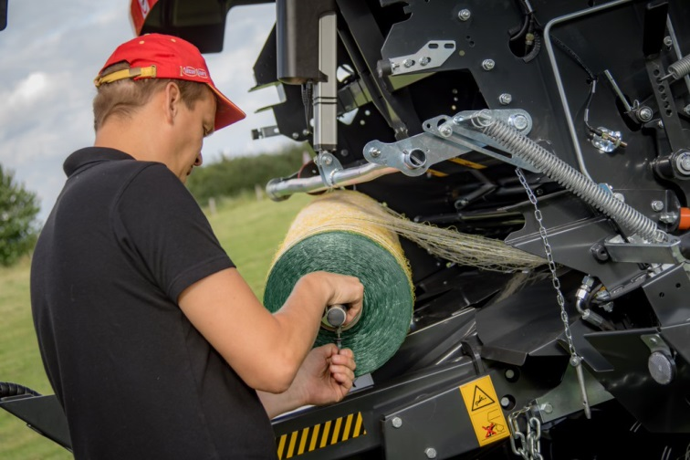
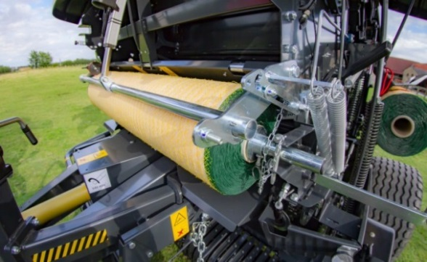
PowerBind Net Wrap System
Front mounted direct injection system for a sure start every time
Positive feed of net into the bale chamber
  Net permanently retained in injection arm, no time spent on first pick up of the net prior to injection
  No effect from windy conditions
  No feed rollers
  Very fast operation
Perfect net spread on the bale
  Net is going fully from side to side
  Edge covering net types can be used
Easy to operate device
  Maximum comfort for the user
    Perfect access to net loading area for servicing
    Fast and comfortable net roll changing and threading
    Fully programmable from control box in tractor cab
Storage for 2 spare net rolls

Slide 21
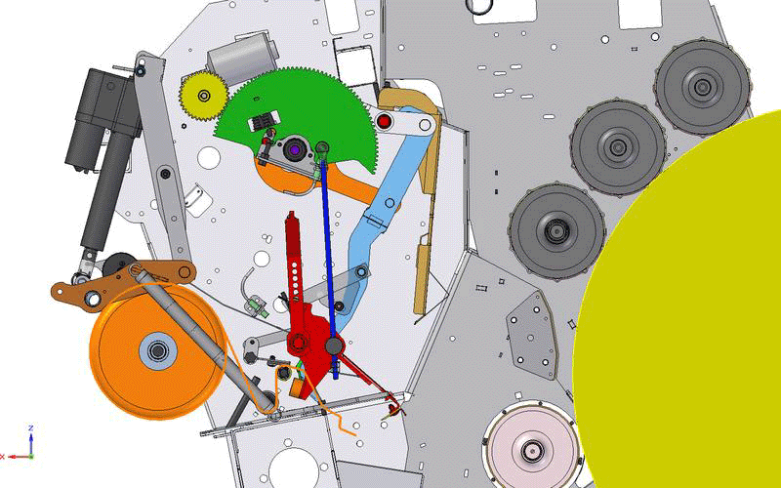
PowerBind Net Wrap System

Slide 22
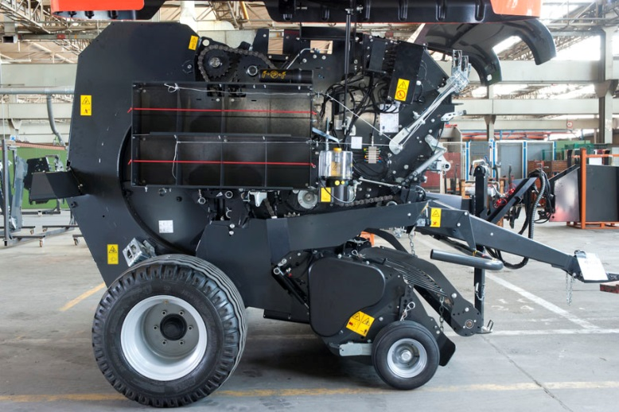
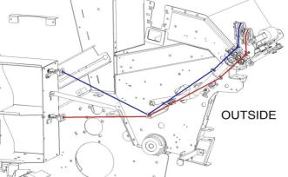
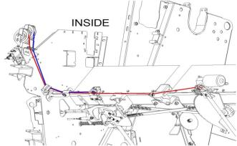
PowerBind Twine System
Perfect twine spacing
  2 Twine arms each cover half the bale
  Cycle starts at the side and finishes in the centre – eliminating loose ends
Efficient and fast operating system
  Forced injection for efficient twine start
  Fast cycle time for improved productivity
  Brake released during injection
  Over-braking during side binding
Easy to operate device
  Easy access to twine boxes
  Simple twine route
  Full control from tractor
Storage for 8 twine bobbins

Slide 23
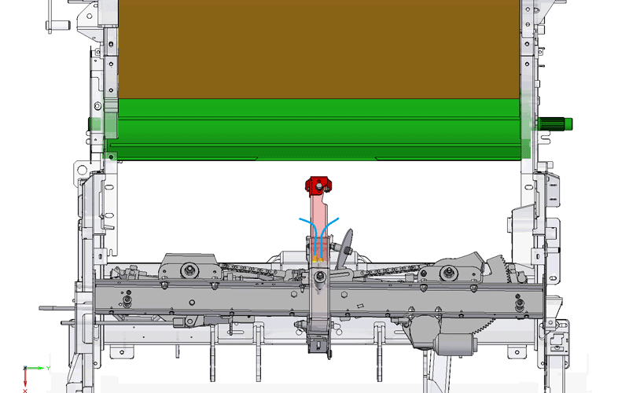
PowerBind Twine System

Slide 24
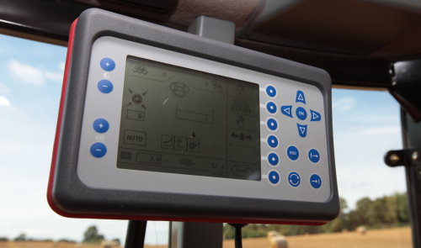
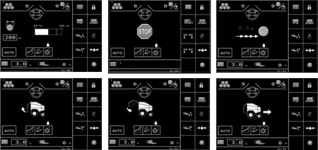
Control box
Simplicity – Efficiency – Productivity
  A very professional easy to use interface
  Intuitive access to all functions
Take the full control on board
  Density adjustment
  Current density (bale growing)
  Left & Right handside indicators
  Twine or net tying selection
  Twine and net tying adjustment
  Tying information during cycle
  Manual or automatic tying mode selection
  Bale counter that can save up to 40 bale counts
  Hydraulic selection control
    Pick-up
    DropFloor
    Knives
  Productivity information (bales per hour)

Slide 25
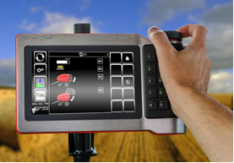
IsoBus Technology (optional)
IsoMatch Tellus GO* - compact ISOBUS Terminal
Full IsoBus terminal
Compact design:
  Easy to integrate in the tractor cab
  7-inch touch screen for perfect machine set-up and control
Hard keys combined with rotary-switch
  Direct access to main functions
  Optimal use while driving
Implement control has never been so easy
* These full ISO terminals can be fitted on the new fixed chamber baler line, provided units are ordered from factory with Isobus connection kit.

Slide 26




The 5 Arguments, Gallignani GF225-255
1
Small diameter pick-up design with 2.0 or 2.2m working width.
2
Cost efficient Fork Feeder, high capacity PowerFeed rotor or SuperCut with 14 knives and DropFloor.
3
RotaMaX bale chamber with a combination of rollers in the front section and chains and slats in the rear. Full versatility in all crops and working conditions.
4
New PowerBind System for fast and reliable net and twine binding. Easy and comfortable net roll loading and threading as well as excellent bale coverage.
5
Simple and intuitive control with the Focus terminal. All functions are shown on a large, clear digital display.

Slide 27

Gallignani GF325 ProLine

Slide 28
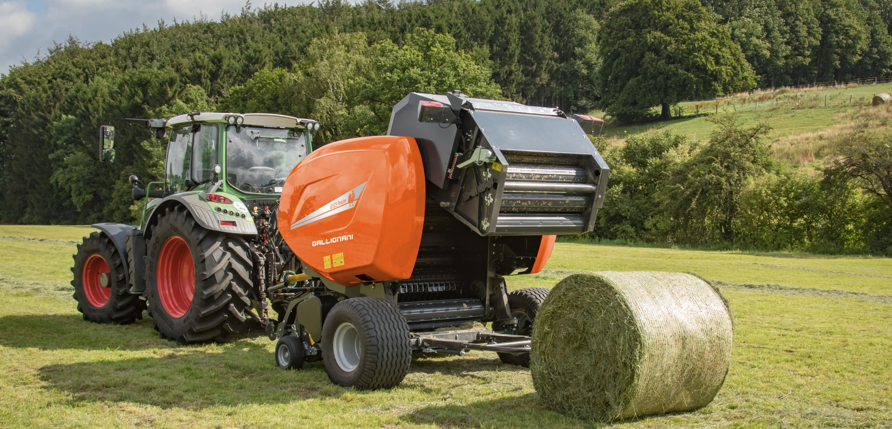
Gallignani GF325
Overview
Model | Bale Diameter | Intake | Binding
GF325 R ProLine | 1.20x1.25m | PowerFeed Rotor | Twine, Net or Double
GF325 SC14 ProLine | 1.20x1.25m | SuperCut-14 | Net or Double
GF325 SC25 ProLine | 1.20x1.25m | SuperCut-25 | Net

Slide 29
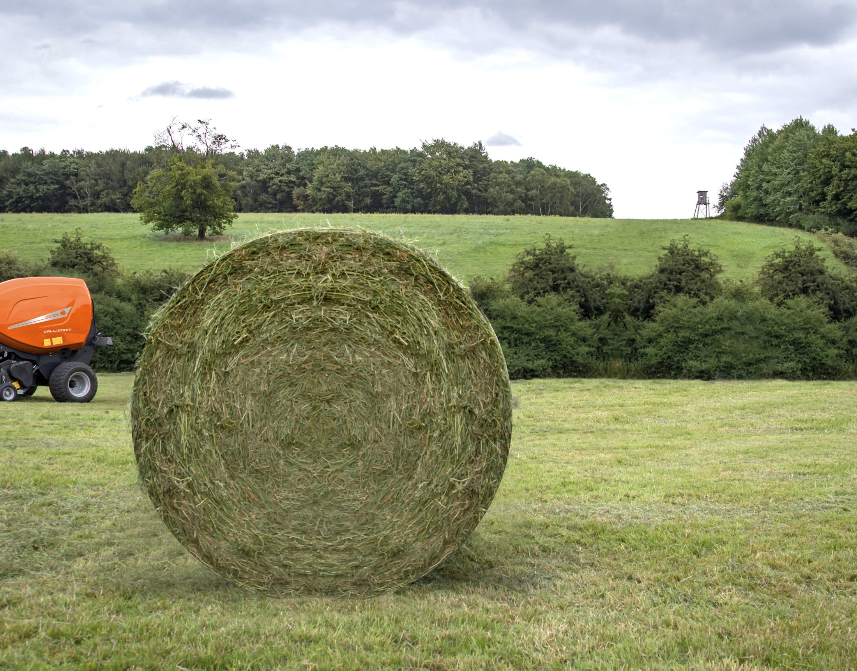
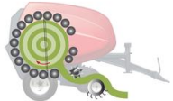
Highlights
PowerBind
New net and twine
binding system
Easy Netting
PowerMax chamber
Full Roller chamber for silage professionals
Easy and simple loading of net rolls for full operator’s comfort.
Focus Terminal
Intake systems
High capacity PowerFeed rotor or SuperCut 14 / 25
DropFloor
New parallelogram
system for excellent
crop clearing
Simple and intuitive Focus control terminal

Slide 30
General specifications
Chamber concept: 17 heavy duty ribbed rollers
Bale size
  1.20 m x 1.25 m
Powerful machine designed for an intensive use in silage conditions
Feeding device - Pick-up:
  Rotor + drop floor ➔ PU 2.20 m + wheels + roller crop press
  SC with 14 knives + drop floor ➔ PU 2.20 m + wheels + roller crop press
  SC with 25 knives + drop floor ➔ PU 2.20 m + wheels + roller crop press
PowerBind with foll. binding options:
  Twine Not on SC
  Net
  Double (net & twine) Not on SC25
Control box
  Focus
Full ISOBUS conversion kit (Optional, allowing the use of Tellus GO monitor)
W-A PTO shaft with Cam Clutch
Wheels ➔ 11.5/80-15 on R version ➔ 15.0/55-17 on SC
Automatic chain lubrication
Greasable bearings with centralized greasing system
Auto greasing system for roller bearings as optional equipment

Slide 31
Pick-up
High capacity – Perfect raking
  Pick-up with 2.20m working width
    1.86 m from outer tines
    5 tine rows
  60 mm tine spacing
  Small diameter pick-up
  High rotation speed
High reliability
  Double cam drive (on 2.20m PU)
  Central bearing supports for tine bars
  Big diameter drive sprocket

Slide 32
Pick-up
The narrowest transport width on the market
  Internal drive (unique feature - patented)
  2.545 m of transport width on 2.20 m PU
Complete standard features
  Roller crop press on 2.20 m PU
  Adjustable pneumatic pick-up wheels
  Suspended on large springs
  Hydraulic lift
2545 mm

Slide 33
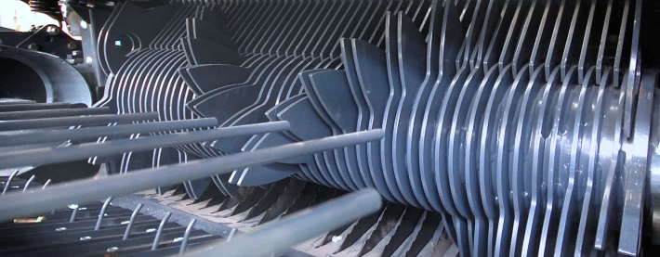
Feeding devices
3 different feeding devices available
  PowerFeed
    Rotor feeding device
  SuperCut-14
    Cutting device with 14 knives
  SuperCut-25
    Cutting device with 25 knives

Slide 34
PowerFeed rotor
Robust and reliable
  400 mm rotor diameter
  Very robust construction
  14 fully guided tines
High capacity in all conditions
  The material is forced into the chamber
  Instant bale start in all the conditions
  Design with opposite tines provides a very high intake capacity with all crops

Slide 35
SuperCut 14-knife cutting device
Reliable cutting device
  400 mm rotor diameter
  14 fully guided double tines
  14 knives controlled from tractor cab
  70 mm theoretical cutting length
High capacity in all conditions
  The material is forced into the chamber through the knives
  Instant bale start in all conditions
  Design with opposite tines provides a very high intake capacity
  DropFloor
Perfect cutting quality
  Hardened knives
  Individually spring-protected knives
  Automatic knife re-engagement

Slide 36
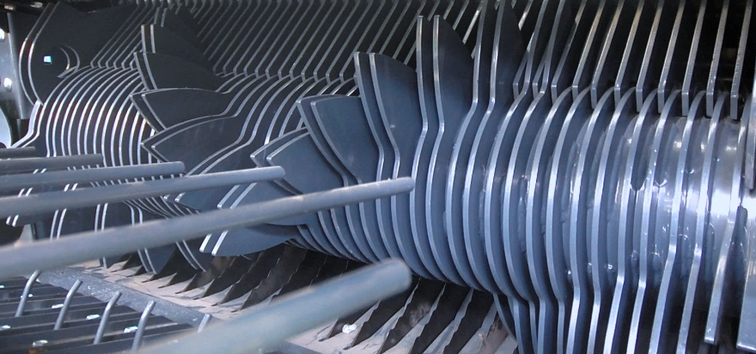

SuperCut 25-knife cutting device
A powerful cutting device
  400 mm rotor diameter
  25 strong full guided double tines
  25 knives controlled from tractor cab
  4 group selections: 6-12-13-25
High capacity in all conditions
  The material is forced into the chamber through the knives
  Instant bale start in all the conditions
  Design with opposite tines provides a very high intake capacity even with 25 knives engaged
  DropFloor
Perfect cutting quality
  Hardened knives
  Individually double spring protected knives
  Automatic knife re-engagement

Slide 37



SuperCut 25-knife cutting device
Strong, unique features
  High flexibility in crops and working conditions thanks to the knife group selection (6, 12, 13 or 25)
  A perfect cutting quality thanks to the double knife protection (patented)
    First protection allows knife to move backwards: knife keeps its cutting effect (small obstacle)
    Second protection allows knife to move down: knife fully down for maximum clearance (large obstacle)
2
1

Slide 38
New DropFloor - unblocking strategy
Full comfort technology
  Operated directly from tractor cab
  Single acting valve needed
Fast and efficient rotor un-blocking device
  Fast operating system
    Select ‘DropFloor’ function on control box
    Remove the hydraulic pressure and re-engage PTO
    Pressure the system back and start baling again
A safe system to remove a blockage
  Increased clearance between floor and rotor thanks to new parallelogram system
  100% efficiency in clearing crop blockages

Slide 39


PowerMax chamber
A powerful chamber
  Full roller chamber concept
    17 heavy duty rollers
    Designed for silage
    Strong concept for baling wet grass
    Greasable bearings for max. efficiency
A good grip on bales
  Small diameter ribbed rollers
    Excellent bale rotation
    Reduced crop loss
High density and nice bale shape
  Rollers are the best solution to obtain high density, nicely shaped bales.
  Less bales in the field and perfect, air tight wrapping

Slide 40

Locking device - Density
Mechanical locking device
High density bales
  Powerful tailgate locking
  Density setting controlled from tractor cab
High reliability of the baler
  Simple mechanical concept
  Maintenance free system
  Strong locking for less stress on tailgate
  No risk of oil leakage

Slide 41

Drive line - Cinematic
Heavy duty driveline
  Split driveline with
    Bale driving on right hand side
    Rotor driving on left hand side
  Strong 1’ ¼ pitch main drive chain
High reliability & low maintenance
  Automatic chain lubrication
  Strong roller shafts and bearings
  Eccentric roller bearings mounting
  Centralized greasable bearings
A secure protection of the baler
  Cam clutch protection on PTO shaft
  Clutch protection on pick-up

Slide 42
Hydraulics
Integration of steel pipes in the hydraulic circuit
  Better protection of critical area
  Professional approach
  Better visual impact

Slide 43
PowerBind Net Wrap System
Front mounted direct injection system for a sure start every time
Positive feed of net into the bale chamber
  Net permanently retained in injection arm, no time spent on first pick up of the net prior to injection
  No effect from windy conditions
  No feed rollers
  Very fast operation
Perfect net spread on the bale
  Net is going fully from side to side
  Edge covering net types can be used
Easy to operate device
  Maximum comfort for the user
    Perfect access to net loading area for servicing
    Fast and comfortable net roll changing and threading
    Fully programmable from control box in tractor cab
Storage for 2 spare net rolls

Slide 44
PowerBind Net Wrap System

Slide 45
PowerBind Twine System
Perfect twine spacing
  2 Twine arms each cover half the bale
  Cycle starts at the side and finishes in the centre – eliminating loose ends
Efficient and fast operating system
  Forced injection for efficient twine start
  Fast cycle time for improved productivity
  Brake released during injection
  Over-braking during side binding
Easy to operate device
  Easy access to twine boxes
  Simple twine route
  Full control from tractor
Storage for 8 twine bobbins

Slide 46
PowerBind Twine System

Slide 47
Control box
Simplicity – Efficiency – Productivity
  A very professional easy to use interface
  Intuitive access to all functions
Take the full control on board
  Density adjustment
  Current density (bale growing)
  Left & Right handside indicators
  Twine or net tying selection
  Twine and net tying adjustment
  Tying information during cycle
  Manual or automatic tying mode selection
  Bale counter that can save up to 40 bale counts
  Hydraulic selection control
    Pick-up
    DropFloor
    Knives
  Productivity information (bales per hour)

Slide 48
IsoBus Technology (optional)
IsoMatch Tellus GO* - compact ISOBUS Terminal
Full IsoBus terminal
Compact design:
  Easy to integrate in the tractor cab
  7-inch touch screen for perfect machine set-up and control
Hard keys combined with rotary-switch
  Direct access to main functions
  Optimal use while driving
Implement control has never been so easy
* These full ISO terminals can be fitted on the new fixed chamber baler line, provided units are ordered from factory with Isobus connection kit.

Slide 49


The 5 Arguments, Gallignani GF325
1
Small diameter pick-up design with 2.2m working width and roller crop press for optimal crop flow
2
High capacity PowerFeed rotor or SuperCut with 14 or 25 knives. New DropFloor with parallelogram as standard equipment.
3
PowerMaX bale chamber with 17 heavy duty ribbed rollers – specifically designed for silage bales in high volumes.
4
New PowerBind System for fast and reliable net and twine binding. Easy and comfortable net roll loading and threading as well as excellent bale coverage.
5
Simple and intuitive control with the Focus terminal. All functions are shown on a large, clear digital display. Tellus GO terminal available as option.

