Slide 1
Variable Chamber Balers
Product Information 2015

Slide 2
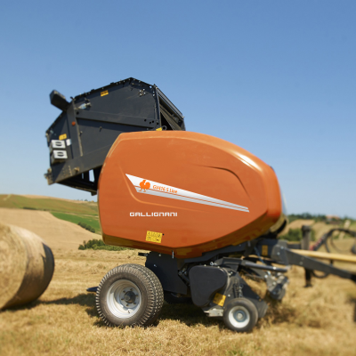
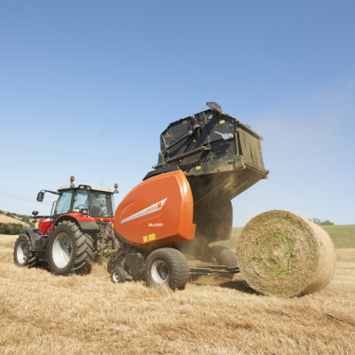
FOTO
Gallignani GV 416-418 S-Line
Gallignani GV 516-520 Pro-Line

Slide 3
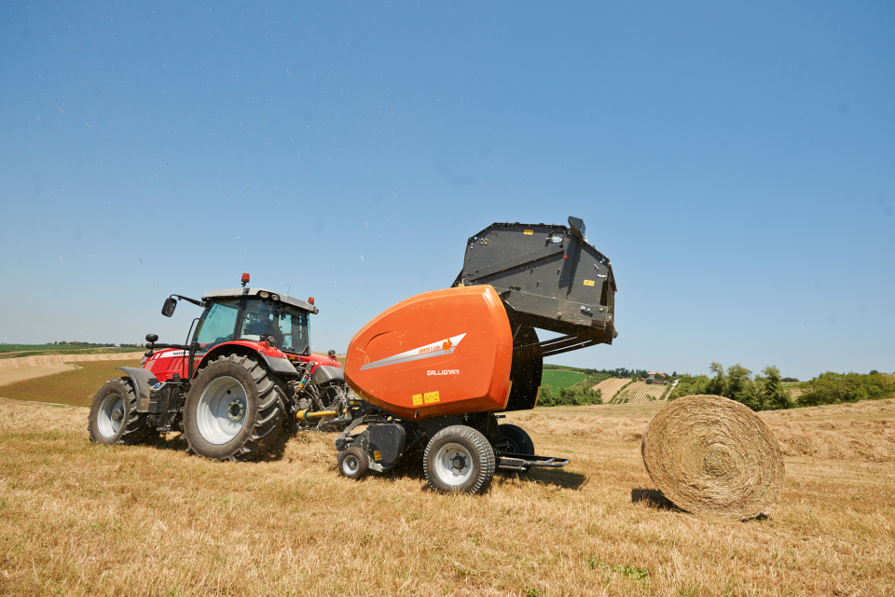

Slide 4
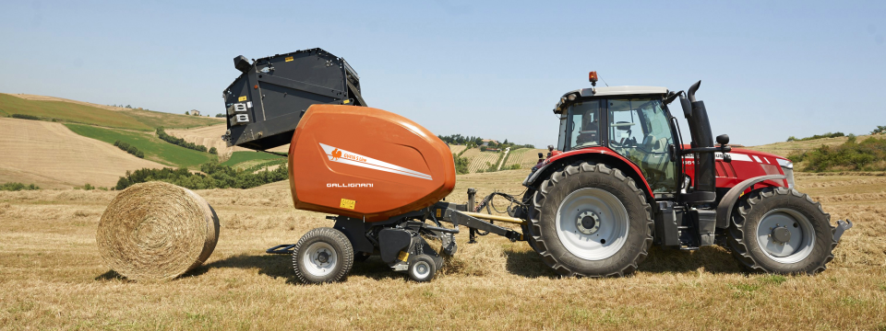

Gallignani GV 416 – 418 S Line
Overview
Model | Bale Diameter | Intake | Binding
GV416 F | 1.2 x 0.8-1.65m | Fork Feeder | Twine, Net, Double
GV416 FD | 1.2 x 0.8-1.65m | DuoFeed Fork | Twine, Net, Double
GV416 R | 1.2 x 0.8-1.65m | PowerFeed Rotor | Twine, Net, Double
GV418 F | 1.2 x 0.8-1.80m | Fork Feeder | Twine, Net, Double
GV418 FD | 1.2 x 0.8-1.80m | DuoFeed Fork | Twine, Net, Double
GV418 R | 1.2 x 0.8-1.80m | PowerFeed rotor | Twine, Net, Double

Slide 5
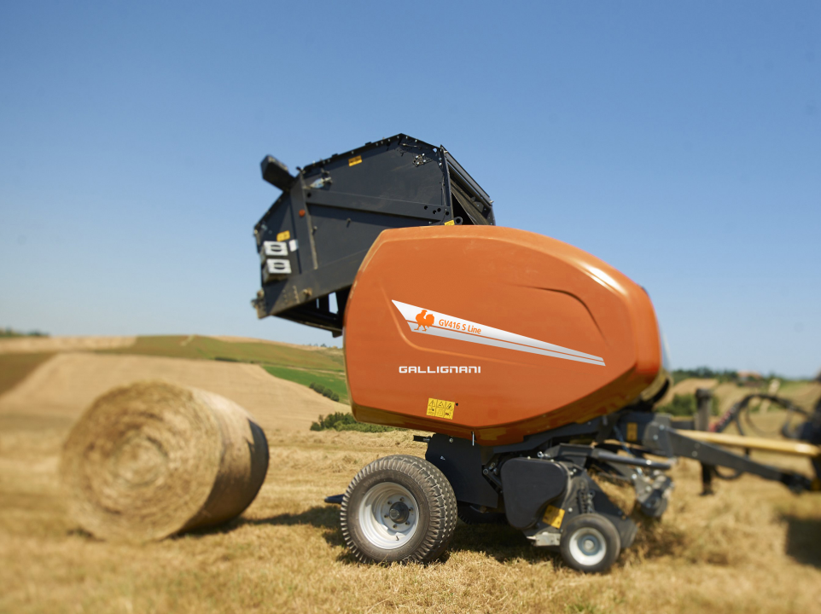
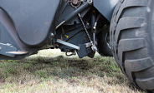
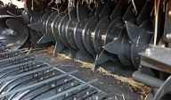
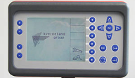
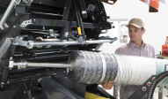
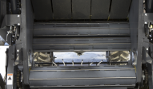
Highlights
DropFloor
Efficient rotor unblocking device
Intake System
Cost efficient Single or Double Fork Feeder or high capacity PowerFeed rotor with DropFloor
Focus Terminal
PowerBind
Bale Density
Simple and intuitive Focus control terminal
New Patented net injection with highly accurate and reliable design
Variable chamber size providing dense bales with a moderate core and tight outer layer

Slide 6
General specifications
Chamber concept: open mixed chamber (more adapted for dry crop baling)
Bale size
  1.20 m x 0.80 to 1.65 m on 4116
  1.20 m x 0.80 to 1.80 m on 4118
Feeding device - Pick-up:
  Feeder fork ➔ PU 2.00 m + wheels + crop deflector
  DuoFeed fork ➔ PU 2.20 m + wheels + crop deflector
  PowerFeed Rotor + DropFloor➔ PU 2.20 m + wheels + roller crop press
Binding options
  Twine
  Net
  Double (net & twine)
Greasable bearings
Focus control box
0-bar or Proportional valve optional
W-A PTO shaft ➔ Shear bolt on Feeder F & FD ➔ Cam Clutch on Rotor
Wheels ➔ 11.5/80-15 on Feeder F & FD ➔ 15.0/55-17 on Rotor
Automatic chain lubrication

Slide 7
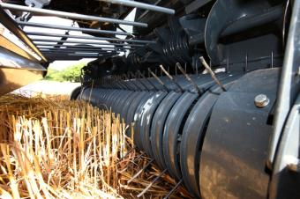
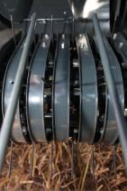
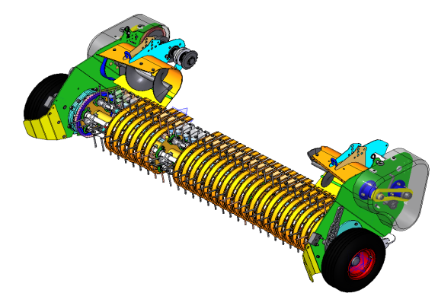
Pick-Up
High capacity – Perfect raking
  Pick-up 2.00 m working width
    Single Fork
    1.66 from outer tines
    4 tine rows
  Pick-up 2.20 m working width
    PowerFeed (Rotor) & DuoFeed
    1.86 m from outer tines
    5 tines rows
  60 mm between 2 tines
  Small diameter pick-up
  High speed rotation
High reliability
  Double cam drive
  Central supports for tine bars
  Big diameter driving sprocket

Slide 8
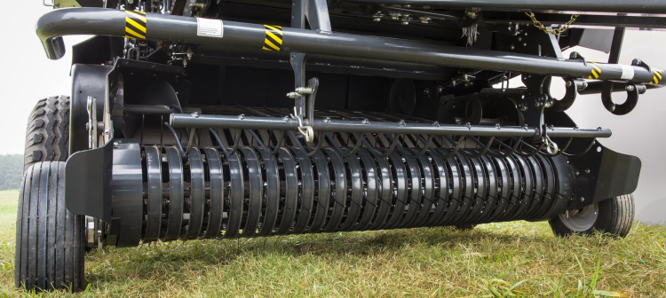
2.0m Pick-Up
  Pick-up 2.00 m working width
    Single fork feeder
    1.66 from outer tines
    4 tine rows
    Crop Deflector

Slide 9
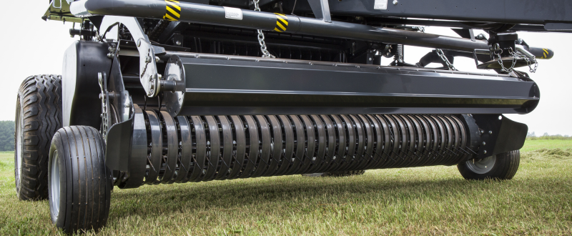
2.2m Wide Pick-Up
  PowerFeed (Rotor) & DuoFeed (Double fork)
    1.86 m from outer tines
    5 tines rows
  60 mm between 2 tines
  Small diameter pick-up
  High speed rotation
  Crop Deflector with roller crop press

Slide 10
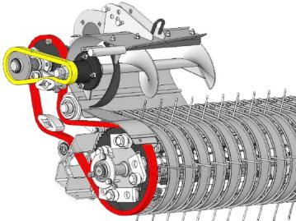
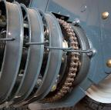
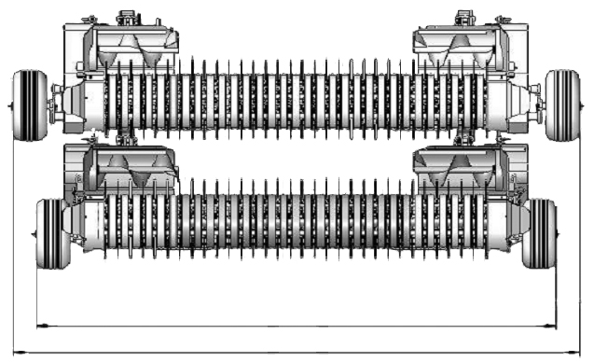
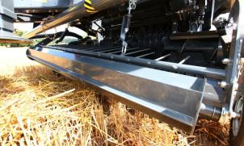
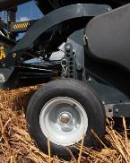
Pick-Up
The most compact transport width of the market
  Internal drive (unique feature - patented)
  2.545 m of transport width on 2.20 m PU
Complete standard features
  Crop deflector on 2.00 m PU
  Roller crop press on 2.20 m PU
  Adjustable pneumatic pick-up wheels
  Big springs suspension
  Lifting-up by 2 hydraulic cylinders
2545 mm

Slide 11
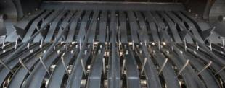
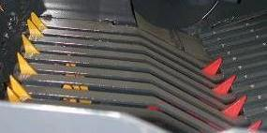
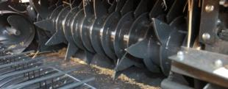
Feeding Devices
3 different feeding devices available
  Feeder Fork
    Fork feeding device
  DuoFeed
    Double fork feeding device
  PowerFeed
    Rotor feeding device

Slide 12
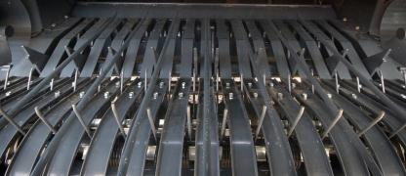
Feeder Fork
Simple and reliable
  Single fork feeder
  Drive by chain
  Shear bolt protected (optional clutch)
Efficient in all conditions
  The material is smoothly pushed into the chamber
  2 augers bring the material to the center
  The system provides a good bale start

Slide 13
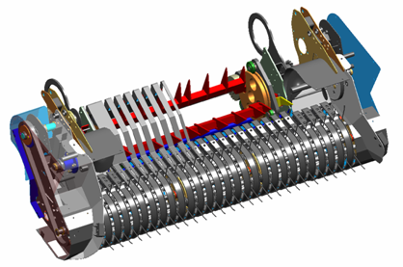
DuoFeeder fork
Simple and reliable
  Double fork feeder
  Drive by chain
  Shear bolt protected
High capacity in all conditions
  The material is pushed into the chamber
  2 augers bring the material to the center
  Instant bale start in all the conditions
  High productivity

Slide 14
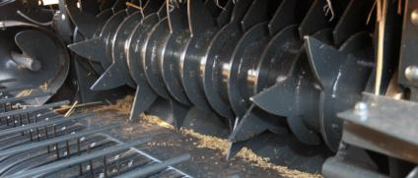
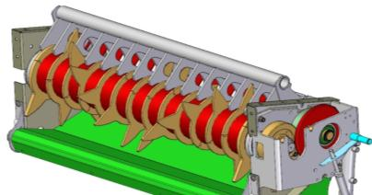
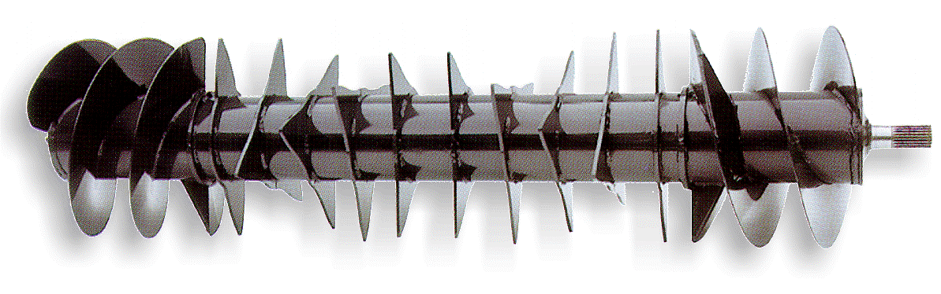
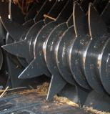
PowerFeed Rotor
Robust and reliable
  400 mm rotor diameter
  Very powerful construction
  13 strong full guided tines
  2 augers bring the material to the center
High capacity in all conditions
  The material is forced into the chamber
  Instant bale start in all the conditions
  The new design with opposite tines provides a very high intake capacity

Slide 15
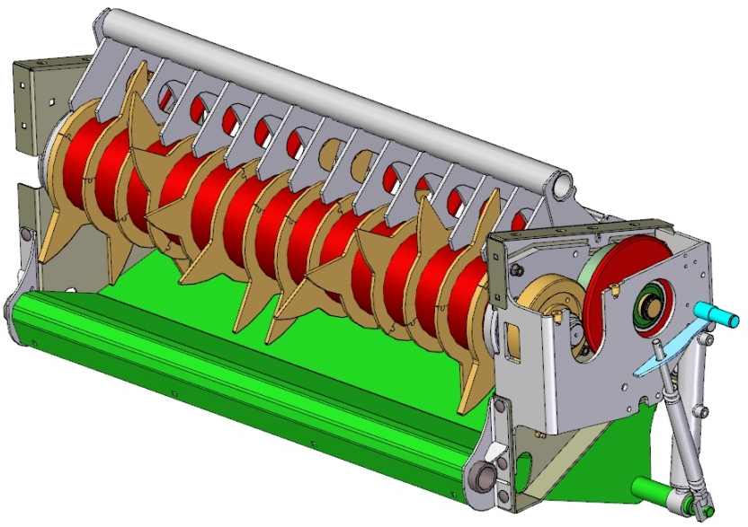
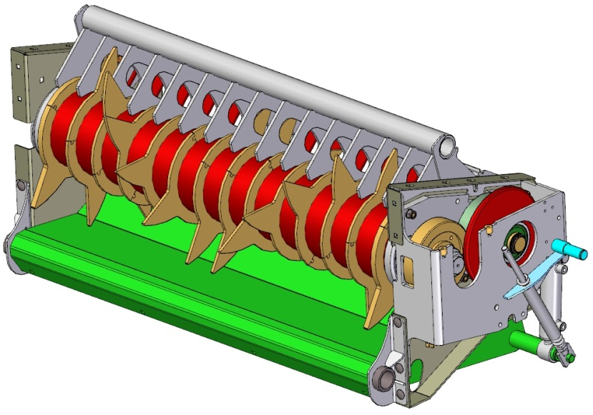
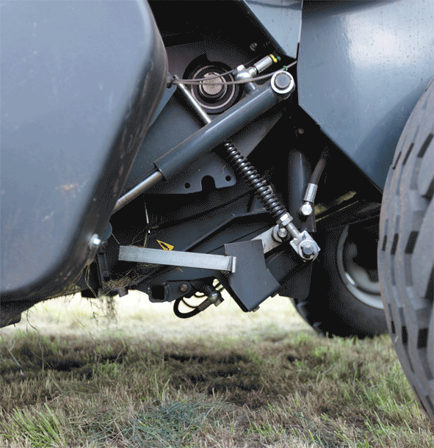
Unblocking strategy (DropFloor)
Easy to use technology
  Operated directly from tractor cab
  Single acting valve needed
Fast and efficient rotor unblocking device
  Fast operating system
    Choose the ‘DropFloor’ control on control box
    Remove the hydraulic pressure and reengage PTO
    Pressure the system back and start baling again
  A safe system to remove a blockage
    Huge clearance between floor and rotor
    100% efficiency of cleaning the blockage

Slide 16
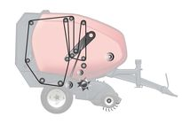
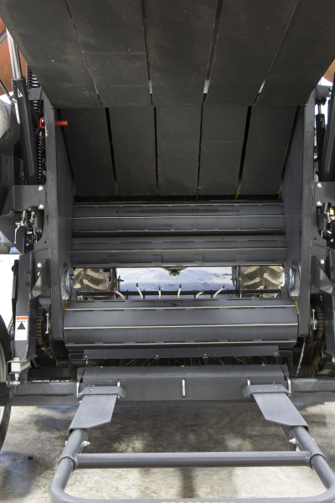
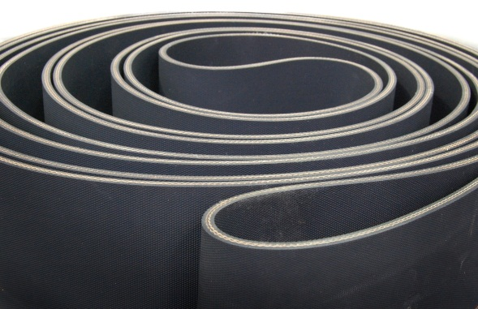
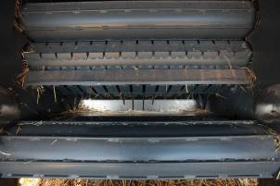
Bale Chamber
A soft core bale chamber
  Open pre-chamber concept
  3 rollers: 1 bottom, 2 front
  5 laced belts
    220 mm width
    Double layers (6 mm thickness)
    Mato lacings
Perfect bale starting in all conditions
  Aggressive roller for better bale rotation
  Mixed core of the bale (belts & rollers)

Slide 17
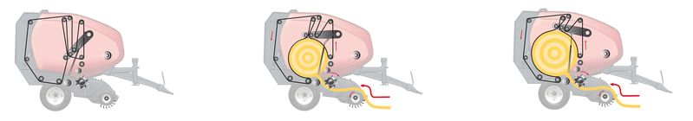
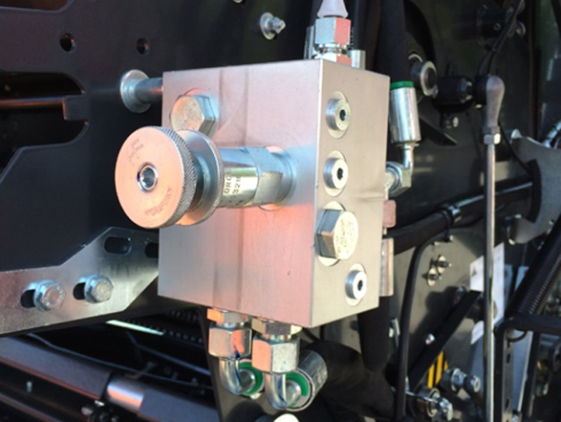
Bale Chamber Concept
Fully adjustable hydraulic density control
  Hydraulic tensioner arm with spring assistance
  As the bale diameter grows, the pressure increases
  Result is a moderate core and firmer outside
  Increased weather protection

Slide 18
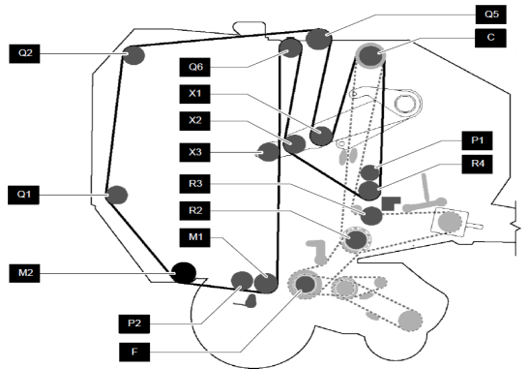
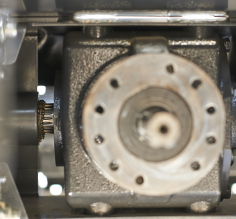
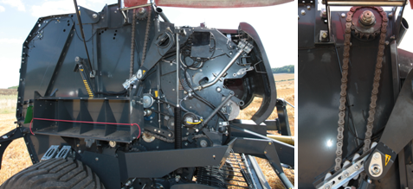
Heavy Duty Drive Line
High reliability & low maintenance
  Strong roller shafts and bearings
  Eccentric roller bearing mountings
  Automatic chain lubrication with pre-set oil flow (according to length of chain) and oiling brushes
  Greasable bearings with central greasing banks
Secure drive line protection for the baler
    PTO With cam clutch protection
    Feeder fork with cam clutch protection

Slide 19
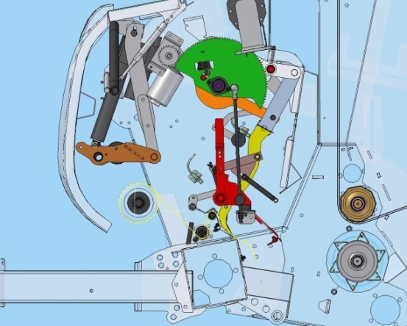
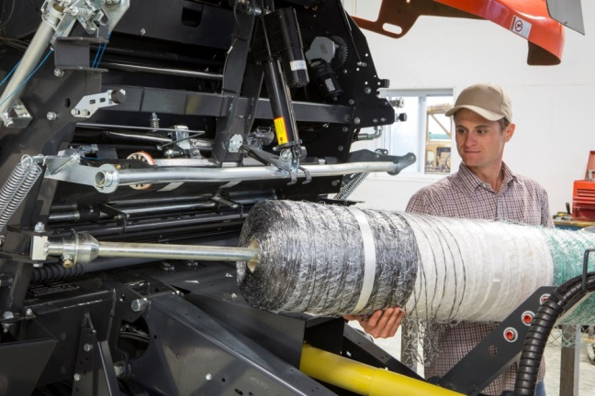
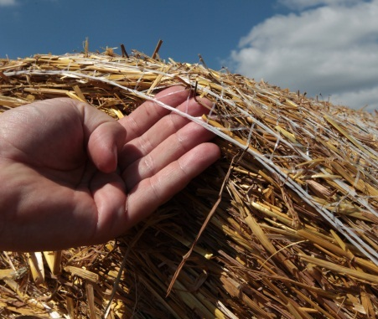
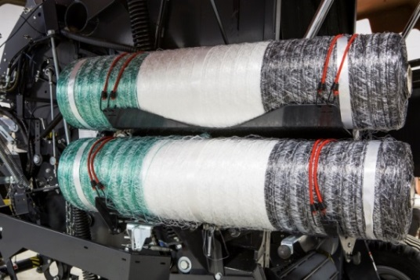
PowerBind - Net Binding
Front mounted direct injection system for a sure start every time
Positive feed of net into the bale chamber
  Net permanently retained in injection arm, no time spent on first pick up of the net prior to injection
  No effect from windy conditions
  No feed rollers
  Very fast operation
Perfect net spread on the bale
  Net is going fully from side to side
  Edge covering net types can be used
  Fast and easy net loading
  Simple and easy threading of net
  Storage for two extra rolls of net

Slide 20
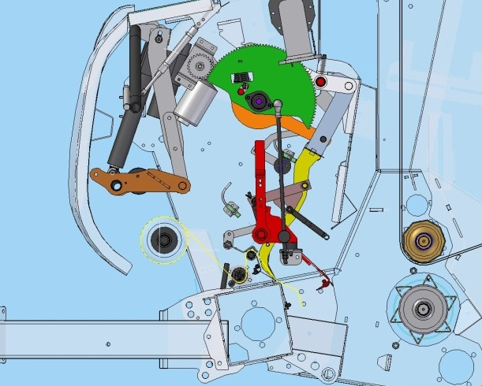
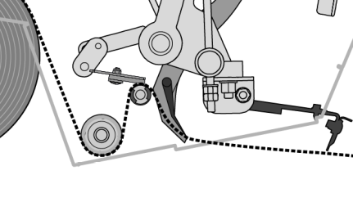
PowerBind Net Wrap

Slide 21
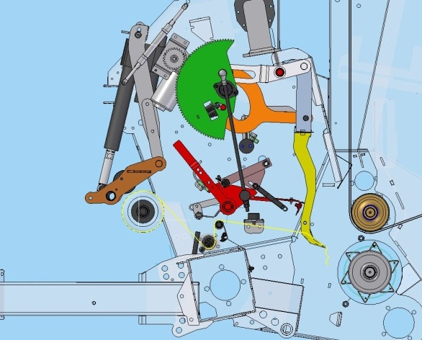
PowerBind Net Wrap

Slide 22
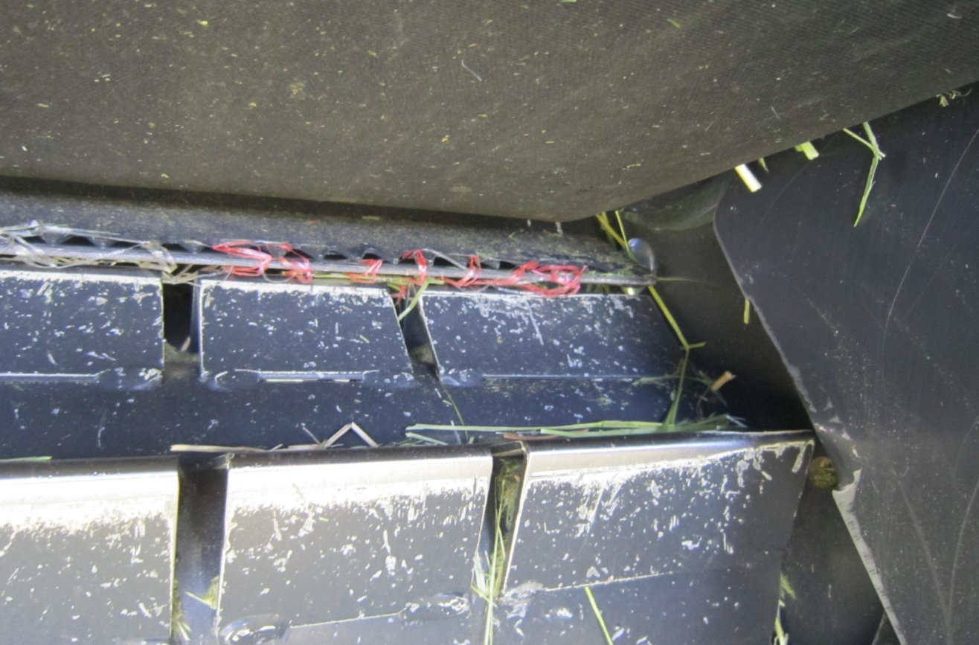
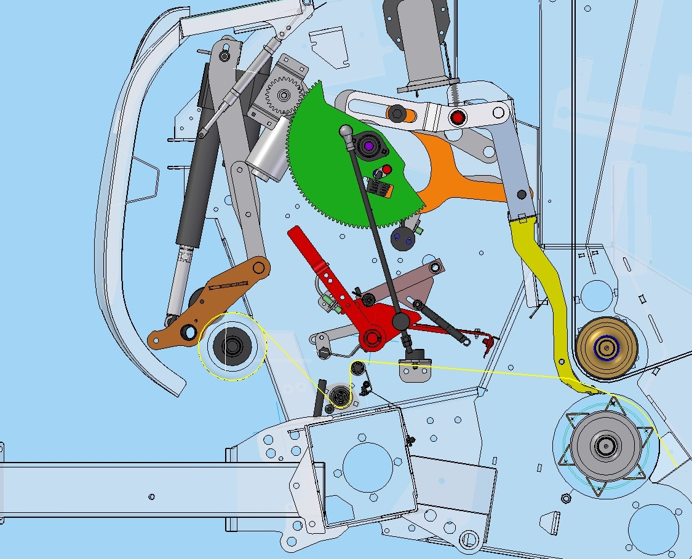
PowerBind Net Wrap

Slide 23

PowerBind Net Wrap

Slide 24
PowerBind Net Wrap

Slide 25



Superb bale quality
Great looking bales in hay & straw crops
  Fantastic shape
  Consistent diameter
  Net to edge of bale
  Bales stack and transport well

Slide 26




Twine Binding
Perfect twine spacing
  2 Twine arms each covering half the bale
  Cycle starts at the side and finishes in the center – eliminating loose ends
Efficient and fast operating system
  Forced injection for efficient twine start
  Faster cycle time for improved productivity
  Brake released during injection
  Over-braking during side binding
Easy to operate
  Easy access to twine boxes
  Twine spacing adjustable from tractor

Slide 27


Storage of Net and Twine
Plenty of storage for net & twine
  Space for two spare net rolls + one in use
  Space for eight balls of twine.

Slide 28


Controls - Focus
Simplicity – Efficiency – Productivity
  Easy to use control system
  Intuitive access to all functions
Full control on board
  Bale diameter adjustment
  Current bale diameter (bale growing)
  Left /Right driving indicator (option)
  Selection of twine or net tying
  Adjustment of twine and net tying
  Information during binding cycle
  Selection of manual or automatic tying
  Total bale counter & 40 field counters
  Performance monitor (bales per hour)

Slide 29




The 5 Arguments, Gallignani GV416 – GV418 S Line
1
Small diameter pick-up design with 2.0 or 2.2m working width.
2
Cost efficient Fork Feeder (single or double) or high capacity PowerFeed rotor with DropFloor.
3
Variable chamber concept with maximum bale diameters of 1.65m or 1.80m providing bales with a moderate core and tight outer layer
4
PowerBind: New highly performant net and twine injection ensuring reliable net and twine injection under all conditions. Easy and simple loading of net rolls.
5
Simple and intuitive control with the Focus terminal. All functions are shown on a large, clear digital display.

Slide 30

Gallignani GV516 – 520 ProLine

Slide 31

Gallignani GV516 – 520 ProLine
Overview
PIC. GV516 ProLine
Model | Bale Diameter | Intake | Binding
GV516 R | 1.2 x 0.6-1.65m | PowerFeed Rotor | Twine, Net, Double
GV516 SC-14 | 1.2 x 0.6-1.65m | SuperCut-14 | Net, Double
GV516 SC-25 | 1.2 x 0.6-1.65m | SuperCut-25 | Net
GV520 R | 1.2 x 0.6-2.00m | PowerFeed Rotor | Twine, Net, Double
GV520 SC-14 | 1.2 x 0.6-2.00m | SuperCut-14 | Net, Double
GV520 SC-25 | 1.2 x 0.6-2.00m | SuperCut-25 | Net

Slide 32


Highlights
FOTO
DropFloor
Efficient rotor unblocking device
Intake System
High capacity PowerFeed rotor or SuperCut 14 or 25 knives
ISOBUS Control
PowerBind
Intelligent Density 3D
Fully ISOBUS compliant. Focus II or IsoMatchTellus monitors on request
New high performance net injection with easy and simple loading of net rolls.
3 different bale densities, pre-selectable from the tractor cab.

Slide 33
General Specifications
Chamber concept: mixed chamber (for multi crop baling)
Bale size
  1.20 m x 0.60 to 1.65 m on GV516
  1.20 m x 0.60 to 2.00 m on GV520
Feeding device - Pick-up:
  Rotor + drop floor ➔ PU 2.20 m + wheels + roller crop press
  SC-14 knives + drop floor ➔ PU 2.20 m + wheels + roller crop press
  SC-25 knives + drop floor ➔ PU 2.20 m + wheels + roller crop press
Binding options
  Twine Not on SC
  Net
  Double (net & twine) Not on SC25
IsoBus controlled - Focus or IsoMatch Tellus control boxes optional
Proportional valve standard (Intelligent Density 3D)
W-A PTO shaft with Cam Clutch
Wheels: 15.0/55-17
Greasable bearings
Automatic chain lubrication
Tear drop plate

Slide 34



Pick-Up
High capacity – Perfect raking
  Small diameter pick-up
  2.20m working width
  1.86m Tine to tine
  6 cm Tine spacing
  5 Rows of tines
  High rotation speed
High reliability
  Double cam drive
  2 central supports for tine bars
  Big diameter driving sprockets

Slide 35
2.2m Wide Pick-Up
  PowerFeed and SuperCut.
    1.86 m from outer tines
    5 tines rows
  60 mm between 2 tines
  Small diameter pick-up
  High speed rotation
  Crop Deflector with roller crop press

Slide 36




Pick-Up
The most compact transport width on the market
  2.545 mm Transport width
  Compact internal drive (unique patented feature)
Complete standard features
  Roller crop press & crop guard for a perfect crop flow
  Adjustable pneumatic pick-up wheels
  Flotation by two large springs
  Pick-up lift by twin hydraulic cylinders
2545 mm
Competitor with external drive system

Slide 37



Feeding devices
3 different feeding devices available
  SuperFeed
    Rotor feeding device
  SuperCut-14
    Cutting device with 14 knives
  SuperCut-25
    Cutting device with 25 knives

Slide 38




Cutting Device 14 Knives (SuperCut-14)
Reliable cutting device
  400 mm Rotor diameter
  14 Strong full guided double tines
  Knives controlled from tractor cab
  70 mm Theoretical chop length
High capacity in all conditions
  The crop is forced into the chamber through the knives
  Instant bale start in all the conditions
Perfect cutting quality
  Hardened knives
  Each knife individually spring protected
  Automatic knife re-engagement

Slide 39


Cutting Device 25 knives (SuperCut-25)
A powerful cutting device
  400 mm rotor diameter
  25 strong full guided double tines
  25 knives controlled from tractor cab
  4 group selections: 0-6-12-13-25
High capacity in all conditions
  The material is forced into the chamber trough the knives
  Instant bale start in all the conditions
  The new design with opposite tines provides a very high intake capacity even with 25 knives
  DropFloor device
Perfect cutting quality
  Hardened knives
  Individually double spring protected knives
  Automatic knives reengagement

Slide 40



Cutting Device 25 knives (SuperCut-25)
A very high flexibility thanks to the group selection
    Fast operating device
    Selection of 0, 6, 12, 13 or 25 knives at work
A perfect cutting quality thanks to the double knife protection (patented)
    First protection allows knife to move backwards: knife keeps its cutting effect
    Second protection allows knife to retract completely
2
1

Slide 41


Unblocking Strategy (DropFloor)
Easy to use technology
  Operate directly from tractor cab
  Single acting valve needed
Fast and efficient rotor un-blocking device
  Fast & easy to use system
    Select ‘Drop floor’ on Focus control box
    Operate tractor valve to lower floor and re-engage PTO
    Operate tractor valve to close floor and start baling again
  A safe system to remove a blockage
    Huge clearance between floor and rotor
    100% efficient blockage clearance

Slide 42



Bale Chamber
Chamber design with reduced critical areas for crop build up in wet conditions
Instant crop rotation
  3 rollers: 1 ribbed bottom, 2 Profiled fronts
  5 endless belts
  220 mm wide
  Triple layer (6 mm thickness)
Good bale start in all conditions
  Two profiled rollers ensure instant bale rotation
  High bale density due to immediate
  rolling and pressurizing

Slide 43


Intelligent Density 3D
Electronic proportional density control
  Hydraulic density control up to 190 bar
  Tensioner arm with twin tension springs
  As the bale grows, the pressure increases
Density control from tractor cab
  Full control over bale structure from tractor seat
  3 different zones adjustable + 0 bar core
  Zero pressure function also allows a soft center bale to be produced if required

Slide 44

Intelligent Density 3D
Baling dry straw and want the heaviest bales possible? Maximum pressure is set in every zone.
Baling hay? Soft center core to let the bale breathe is set, with gradually increasing pressure towards the outer layer.
Baling silage? Reduced pressure settings to suit wetter crop conditions.
Pre-programmed settings for different crop types

Slide 45


PowerBind - Net Binding
Front mounted direct injection system for a sure start every time
Positive feed of net into the bale chamber
  Net permanently retained in injection arm, no time spent on first pick up of the net prior to injection
  No effect from windy conditions
  No feed rollers
  Very fast operation
Perfect net spread on the bale
  Net is going fully from side to side
  Edge covering net types can be used
Fast and easy net loading
  Simple and easy threading of net
  Storage for two extra rolls of net

Slide 46
PowerBind Net Wrap

Slide 47
PowerBind Net Wrap

Slide 48
PowerBind Net Wrap

Slide 49
PowerBind Net Wrap

Slide 50
PowerBind Net Wrap

Slide 51

Superb bale quality
Great looking bales in silage, hay & straw
  Fantastic shape
  Consistent diameter
  Net to edge of bale
  Stack and transport well

Slide 52
Twine Binding
Perfect twine spacing
  2 Twine arms each covering half the bale
  Cycle starts at the side and finishes in the center – eliminating loose ends
Efficient and fast operating system
  Forced injection for efficient twine start
  Faster cycle time for improved productivity
  Brake released during injection
  Over-braking during side binding
Easy to operate
  Easy access to twine boxes
  Twine spacing adjustable from tractor

Slide 53
Storage of Net and Twine
Plenty of storage for net & twine
  Space for two spare net rolls + one in use
  Space for eight balls of twine.

Slide 54


Drive Line
Heavy duty split driveline
  Bale chamber driven from right hand side
  Rotor driven from left hand side
  1¼" Pitch bale chamber drive chain
High reliability & low maintenance
  Automatic chain lubrication
  Remote greasable bearings on fixed rollers
  Strong rollers shafts and bearings
  Eccentric roller bearing mountings
Secure protection of the baler
  Cam clutch protection on PTO shaft
  Cam clutch protection on pick-up

Slide 55



Full ISOBUS Compatibility
Simplicity – Efficiency – Productivity
  Choose between Focus (Mono) or IsoMatch Tellus (color touch-screen) terminal
  Connect directly to an ISO compatible tractor display in a few seconds
  Very easy to use interface
Full control on board
  Bale diameter adjustment
  Density adjustment in three zones
  Current bale diameter (bale growing)
  Left/Right driving indicator
  Selection of twine or net binding
  Adjustment of twine and net binding cycles Manual or automatic binding start
  Total bale counter & 40 field counters
  Selection of pick-up, drop floor & knives
  Performance monitor (bales per hour)
AGCO
CNH

Slide 56


The 5 Arguments, Gallignani GV516 – GV520 ProLine
1
2.2m pick-up with small diameter reel for fast and efficient throughput.
2
PowerFeed rotor, SuperCut 14 or 25 knives and DropFloor for easy unblocking
3
Intelligent Density 3D - Bale density, pre-selectable from the tractor cab. Multi-crop baler for use in silage, hay and straw.
4
PowerBind: New accurate and dependable net and twine injection – net is injected in a flat movement to ensure reliable net injection under all conditions.
5
ISOBUS control. Choice between Focus II terminal and IsoMatch Tellus control terminal with 12” screen and 2 interface screens.

